Slide 1
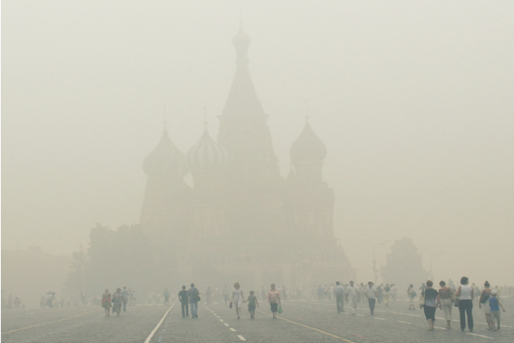
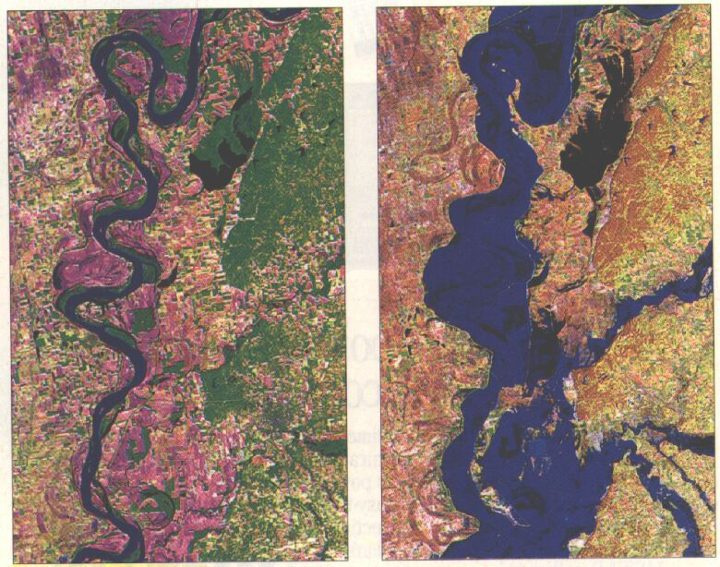
Physics of Extreme Climate Events:
Illustration Via Attribution of Two Cases
Martin Hoerling
with Kathy Pegion, Judith Perlwitz, Jon Eischeid, and Xiaowei Quan

Slide 2
Physics of Extreme Climate Events:
Illustration Via Attribution of Two Cases
Martin Hoerling
with Kathy Pegion, Judith Perlwitz, Jon Eischeid, and Xiaowei Quan
What are extreme climate events, from a physical perspective?

Slide 3
Physics of Extreme Climate Events:
Illustration Via Attribution of Two Cases
Martin Hoerling
with Kathy Pegion, Judith Perlwitz, Jon Eischeid, and Xiaowei Quan
What are extreme climate events, from a physical perspective?
They are often a sequence of weather events whose cumulative affects over weeks or months can result in an extreme time averaged state.
° A severe seasonal drought as a consequence of too many, consecutive sunny days.
° A intense monthly heat wave as a consequence of an unbroken string of hot days.
° A record seasonal flood due to numerous heavy rain events on saturated soils.

Slide 4
Physics of Extreme Climate Events:
Illustration Via Attribution of Two Cases
Martin Hoerling
with Kathy Pegion, Judith Perlwitz, Jon Eishceid, and Xiaowei Quan
What are extreme climate events, from a statistical perspective?

Slide 5
Physics of Extreme Climate Events:
Illustration Via Attribution of Two Cases
Martin Hoerling
with Kathy Pegion, Judith Perlwitz, Jon Eishceid, and Xiaowei Quan
What are extreme climate events, from a statistical perspective?
They are often low probability states of a historical frequency distribution, though they may also be associated with extreme impacts rather than unusual climate states.
° A percentile of a probability distribution function (PDF).
° An event having frequency of occurrence of less than 5% of the time.
° Extreme Value Theory to describe statistics of extremes in the PDF tails, or to
describe events outside the historical data range.

Slide 6
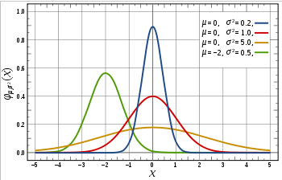
Frequency Distributions : 101
Mean & Variance
More values near the mean, less in the tails
Standard Normal
Less values near the mean, more in the tails

Slide 7
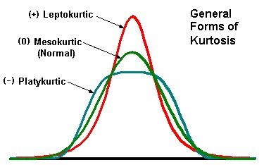
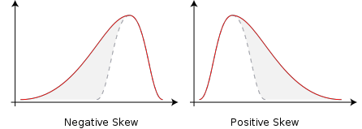
Frequency Distributions : 101
Mean & Variance
More values near the mean, less in the tails
Standard Normal
Less values near the mean, more in the tails
Skewness
(Excess) Kurtosis
Extreme events more likely to occur on the negative side of the mean
Extreme events more likely to occur on the positive side of the mean
Mesokurtic (0): Normal distribution, reference
Leptokurtic (+): more variability due to a few extreme events
Platykurtic (-): more variability due to events closer to mean

Slide 8
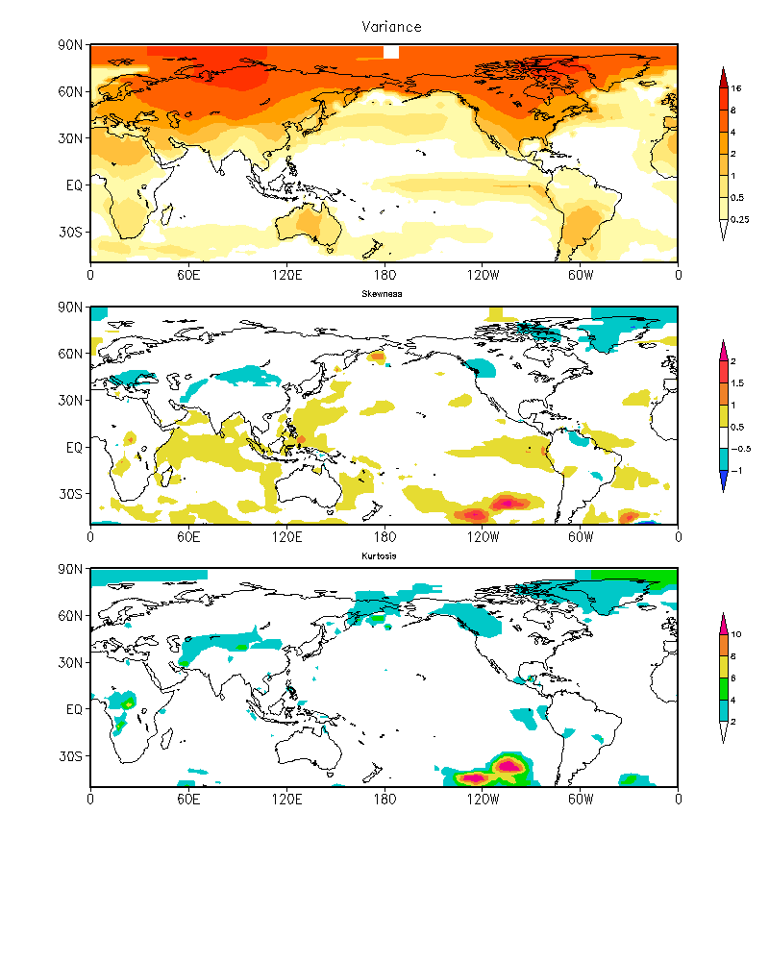
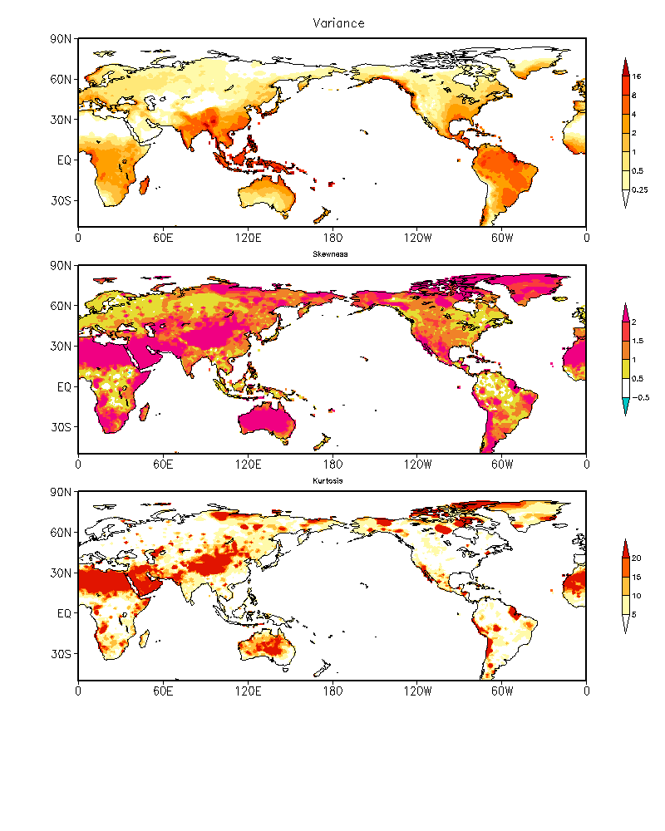
Global Characteristics of Monthly Climate Variability
Observed Monthly SFCT
Observed Monthly PCPN
Variance
Skew
Kurtosis

Slide 9
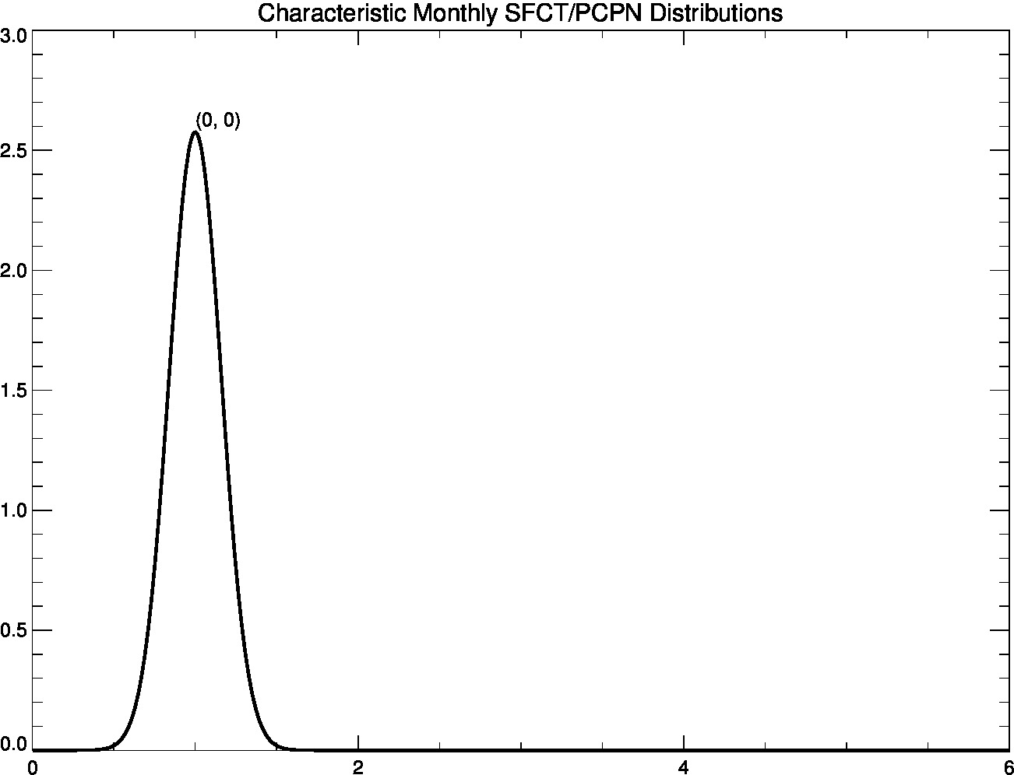
Typical Monthly SFCT PDF

Slide 10
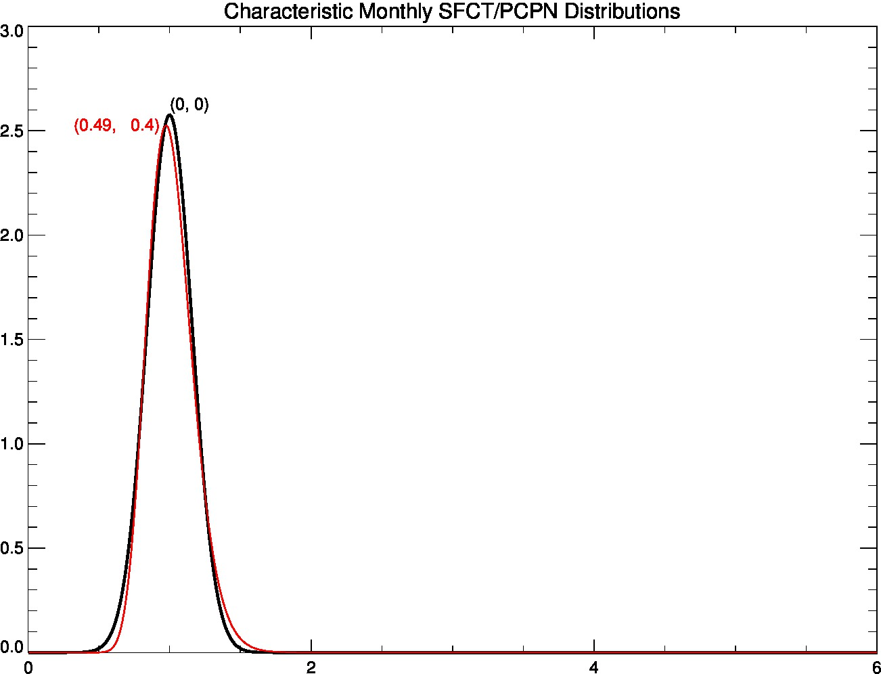
Typical Monthly PCPN PDF in Humid Regions

Slide 11
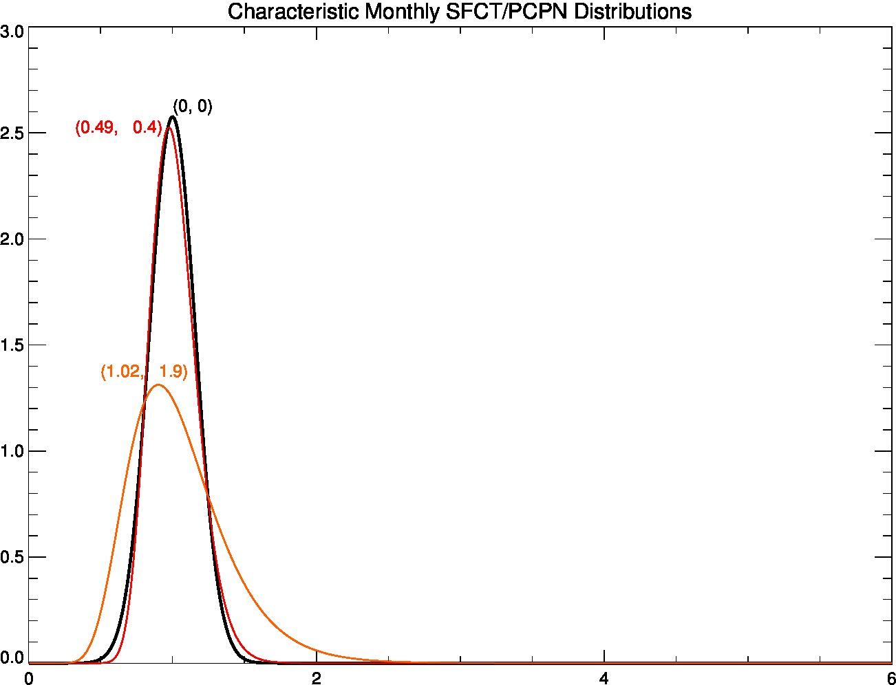
Typical Monthly PCPN PDF in Semi-Arid/Moist Regions

Slide 12
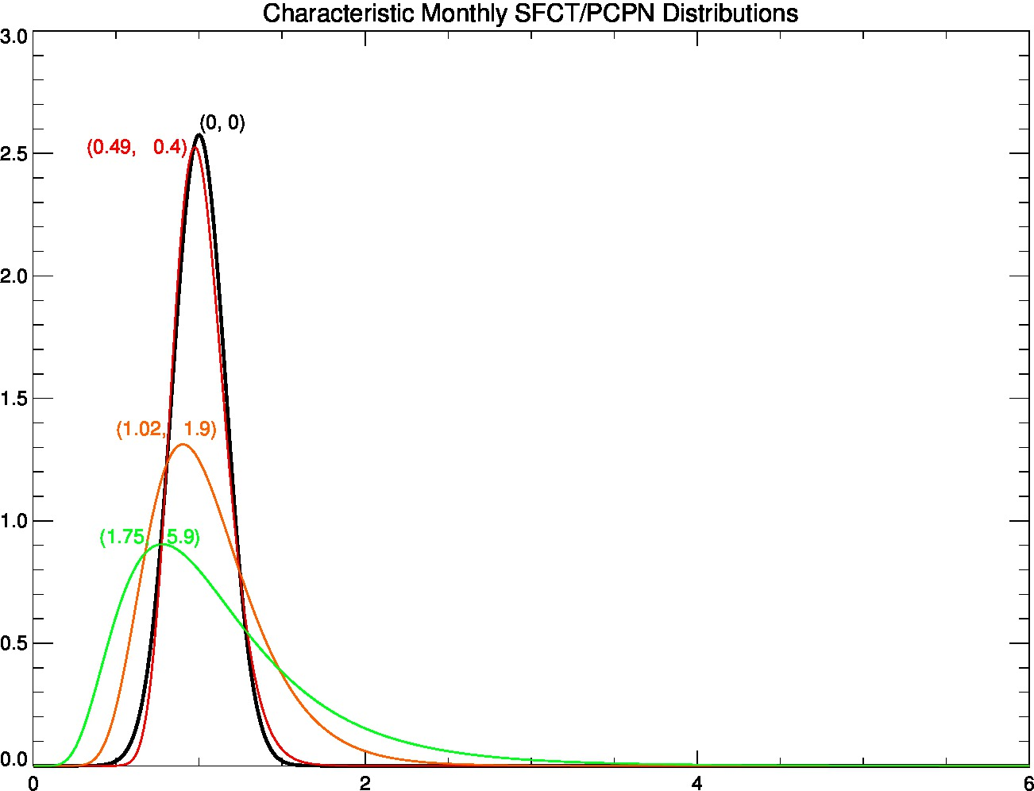
Typical Monthly PCPN PDF in Arid Regions

Slide 13
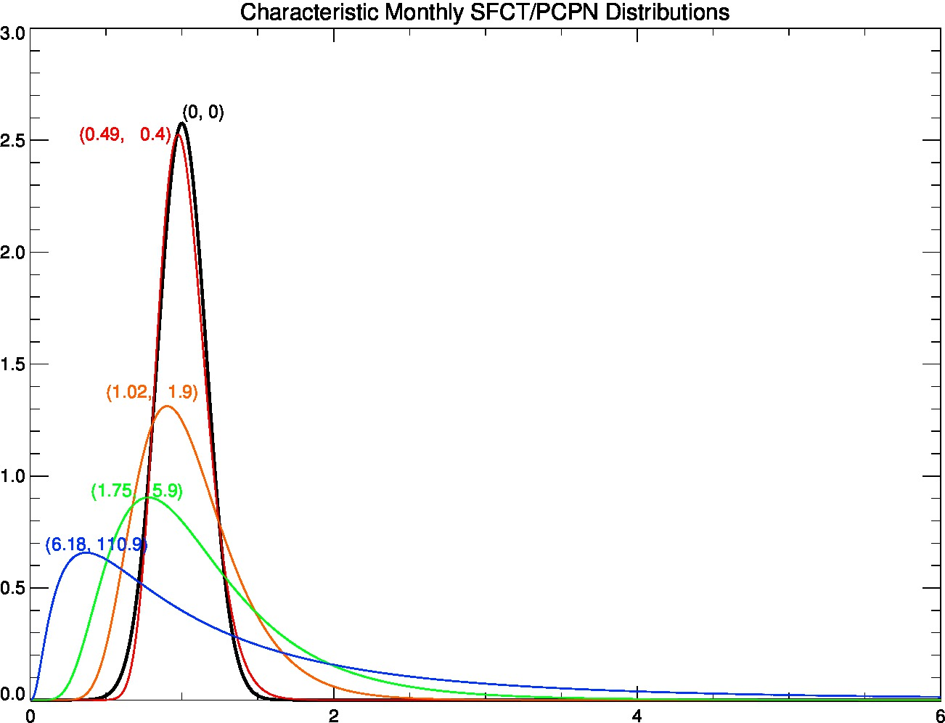
Typical Monthly PCPN PDF in Desert Regions

Slide 14
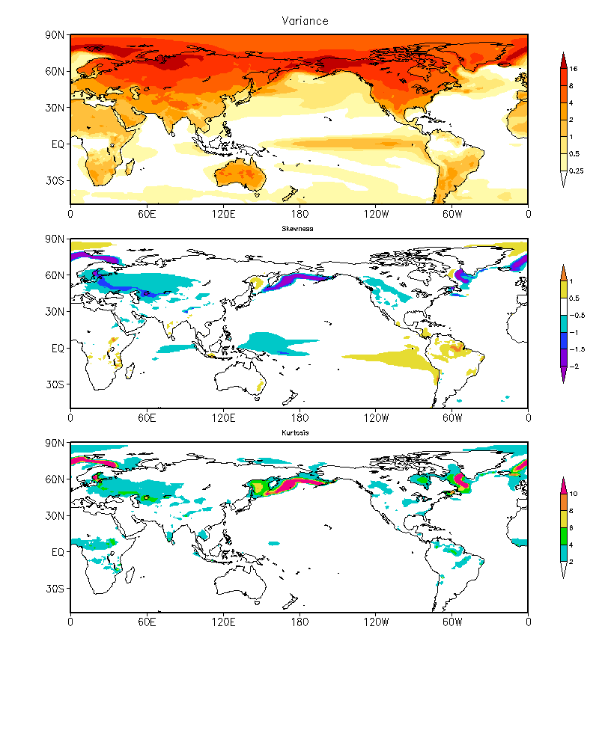
Global Characteristics of Monthly SFCT Variability
CCSM4 Pre-Industrial (1300 yrs)
Observations
Variance
Skewness
Kurtosis

Slide 15
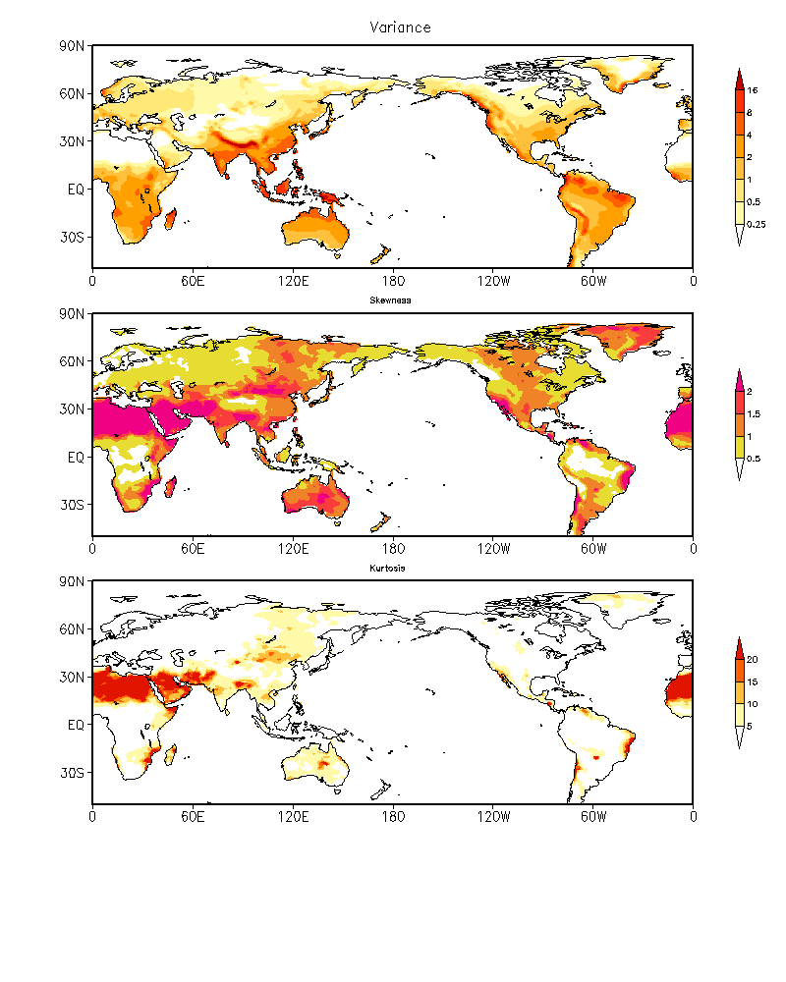
Global Characteristics of Monthly PCPN Variability
Variance
CCSM4 Pre-Industrial (1300 yrs)
Observations
Variance
Skewness
Kurtosis

Slide 16
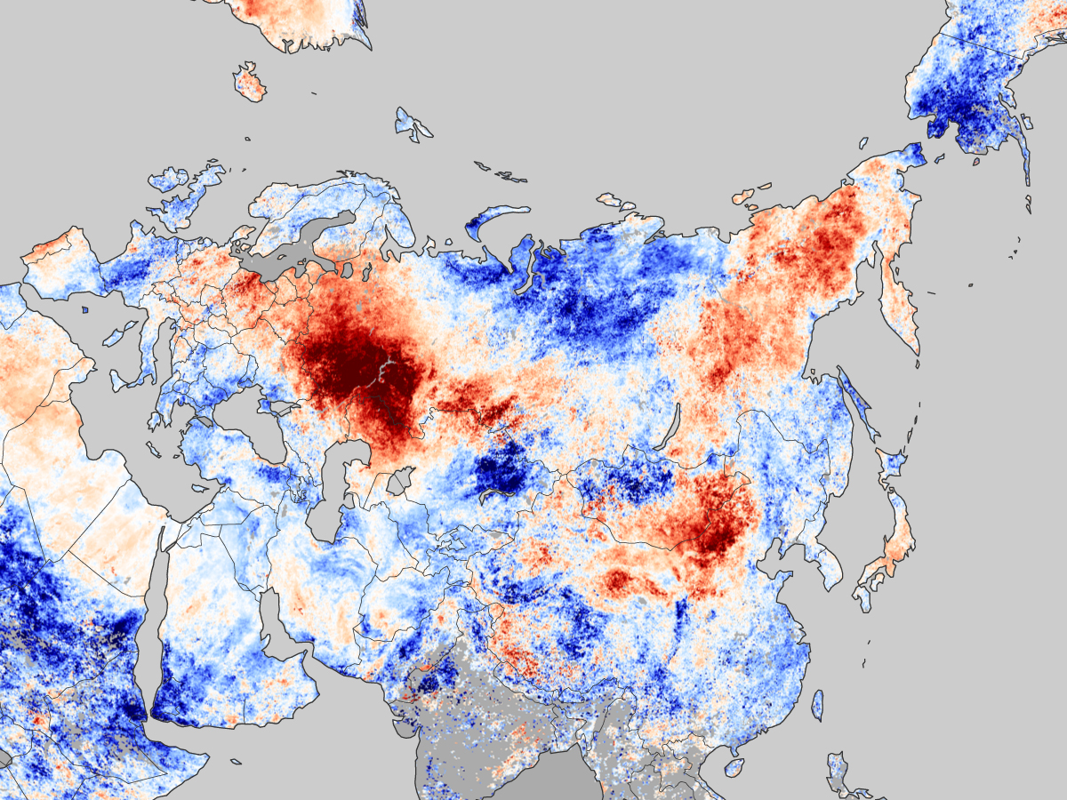
The 2010 Russian Heat Wave

Slide 17
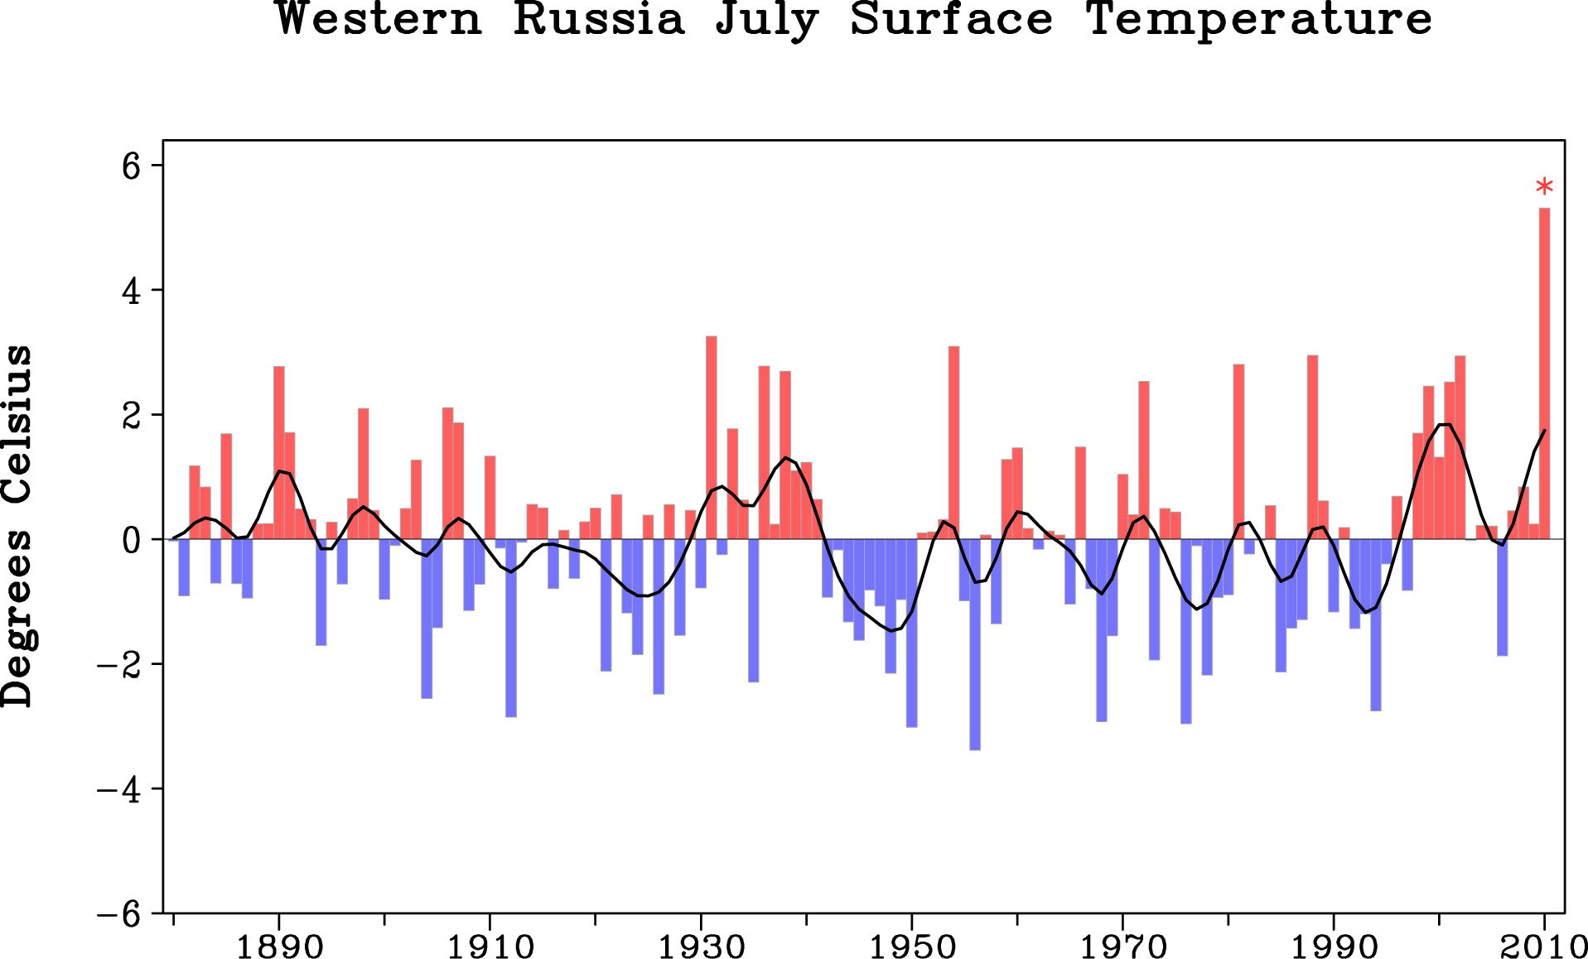

Slide 18
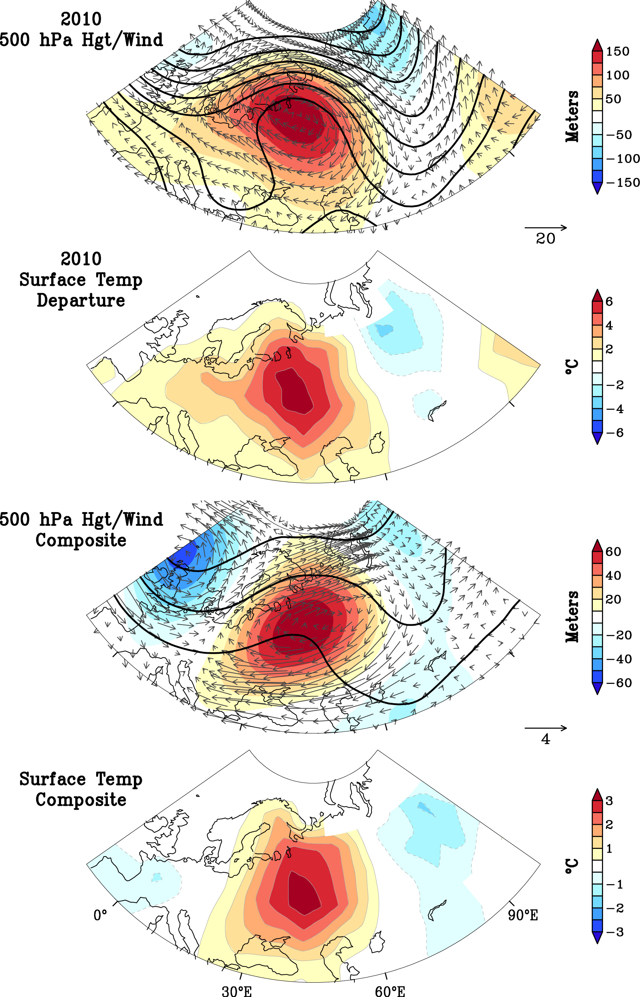
2010 Conditions

Slide 19
2010 Conditions
Historical Heat Waves

Slide 20
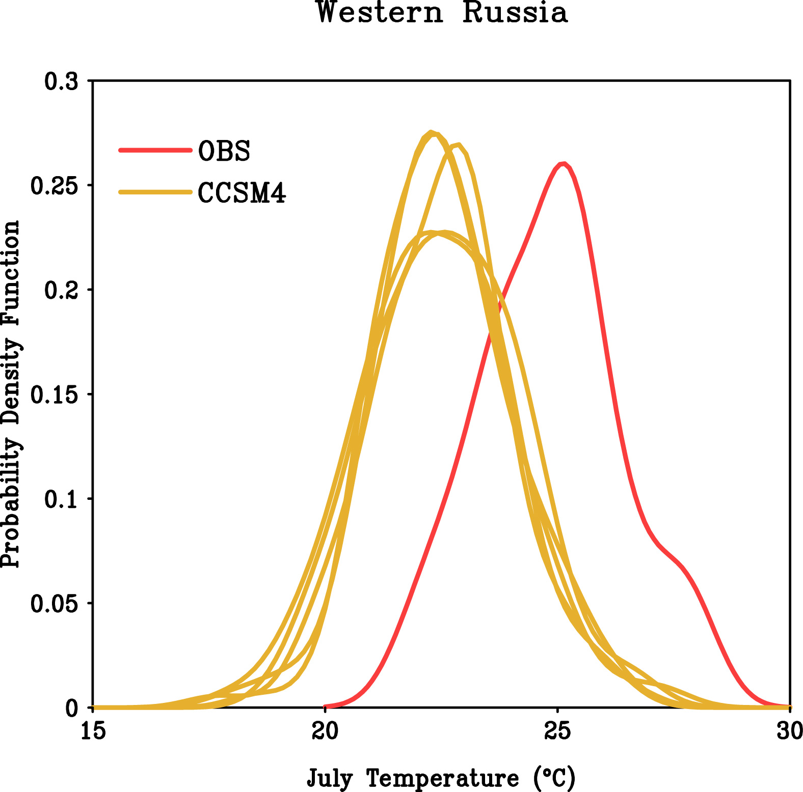
Statistics of July Monthly SfcT: Observed vs Simulations
-2°C Bias
1900-2009 July SfcT

Slide 21
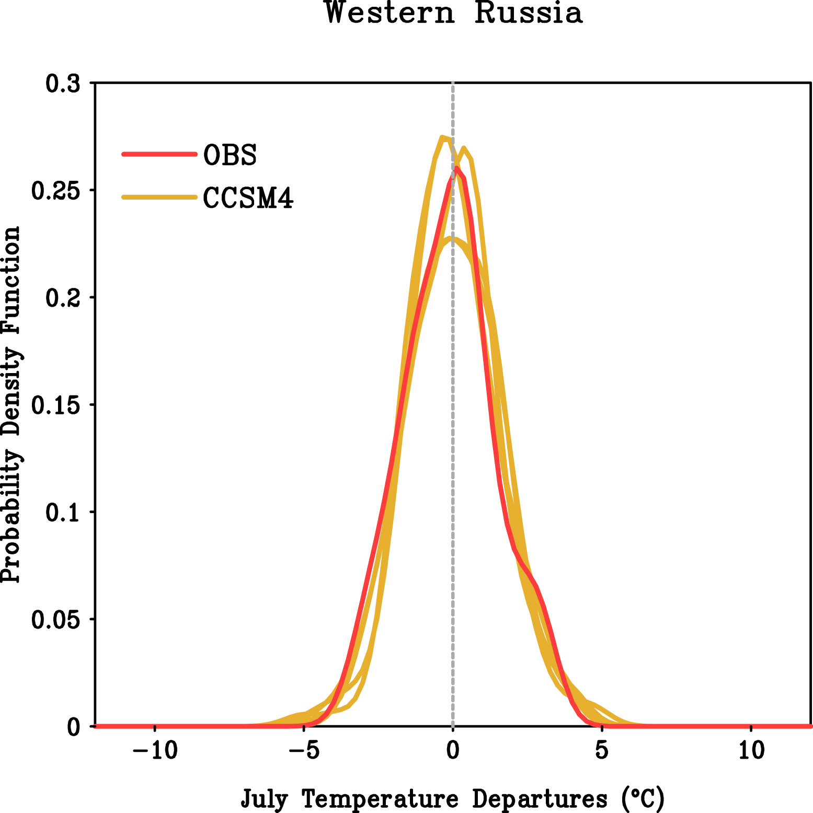
Statistics of July Monthly SfcT Anomalies: Observed vs Simulations
σ² ≈ 2.2°Χ²
Σ≈ 0.1
2010
1900-2009 July SfcT Departures

Slide 22
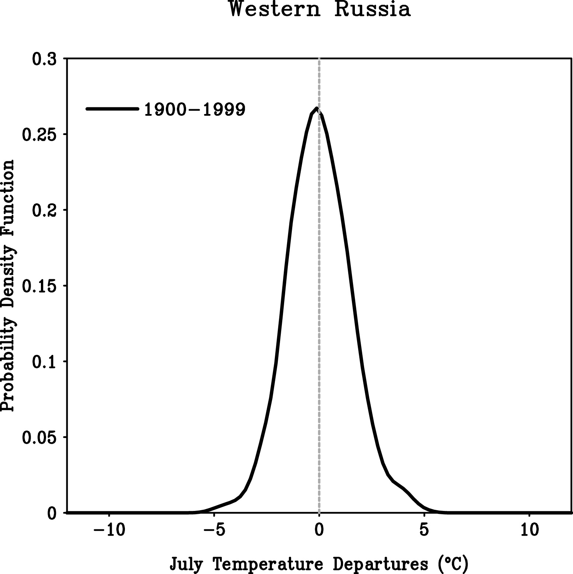
The 2010 Extreme Heat Wave : Climate Change or Climate Variability?
σ² ≈ 2.2°Χ²

Slide 23
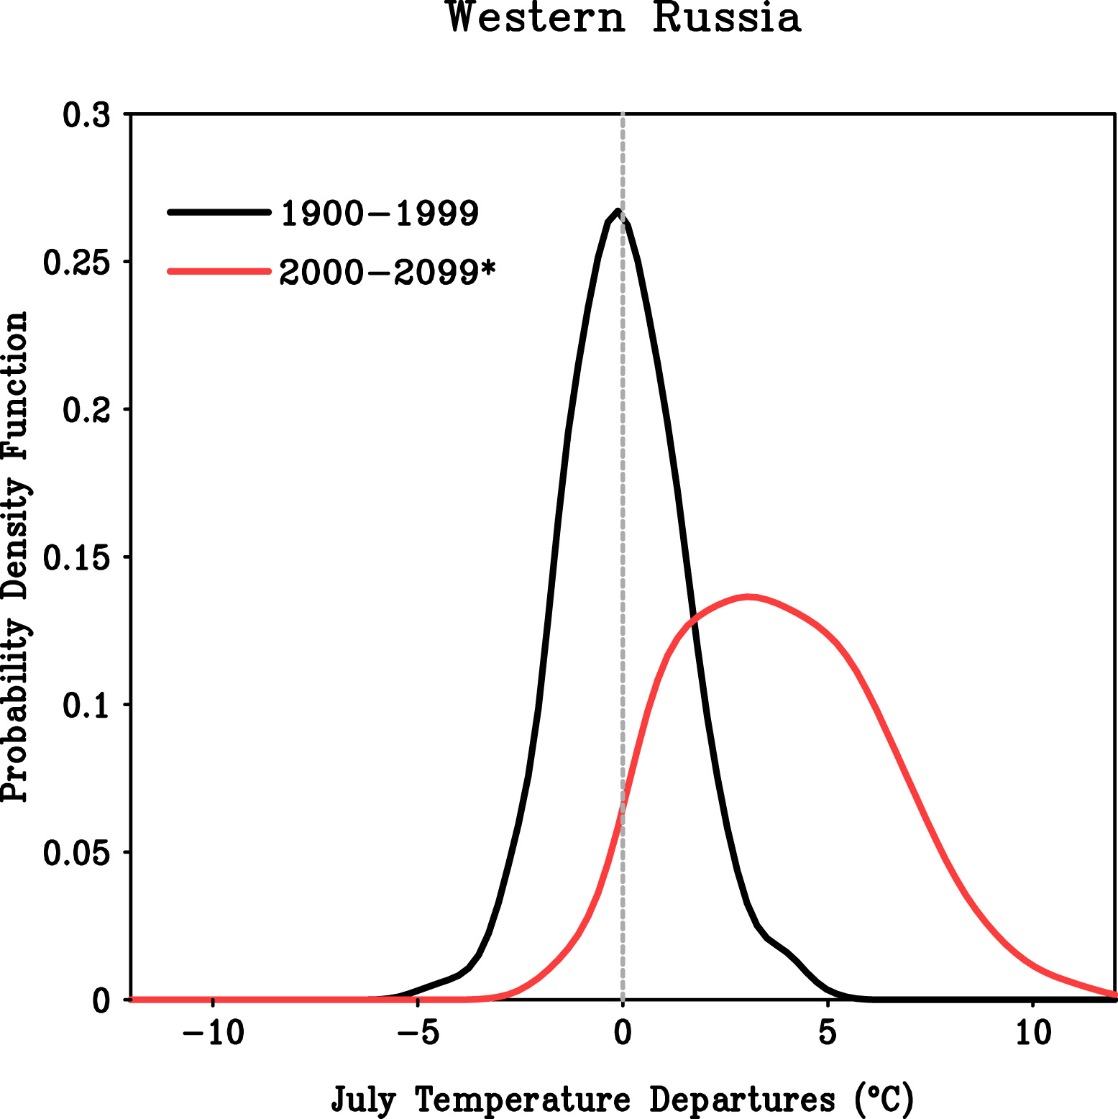
The 2010 Extreme Heat Wave : Climate Change or Climate Variability?
σ² ≈ 2.2°Χ²
σ² ≈ 6.4°Χ²
2010
CCSM4 Emissions Scenario “Message 8.5”

Slide 24
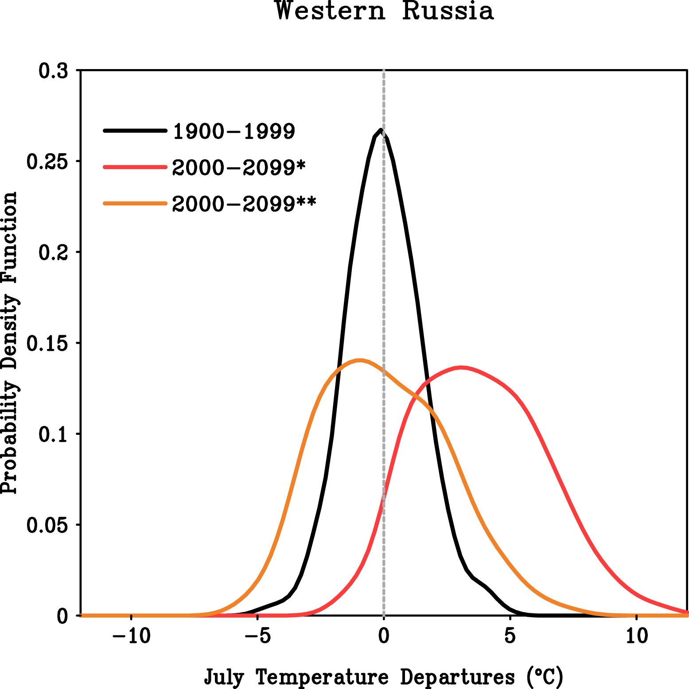
Will There Be Increased Extreme Heat Waves in the 21st Century?
σ² ≈ 2.2°Χ²
σ² ≈ 6.4°Χ²
σ² ≈ 6.3°Χ²
CCSM4 Emissions Scenario “Message 8.5”

Slide 25
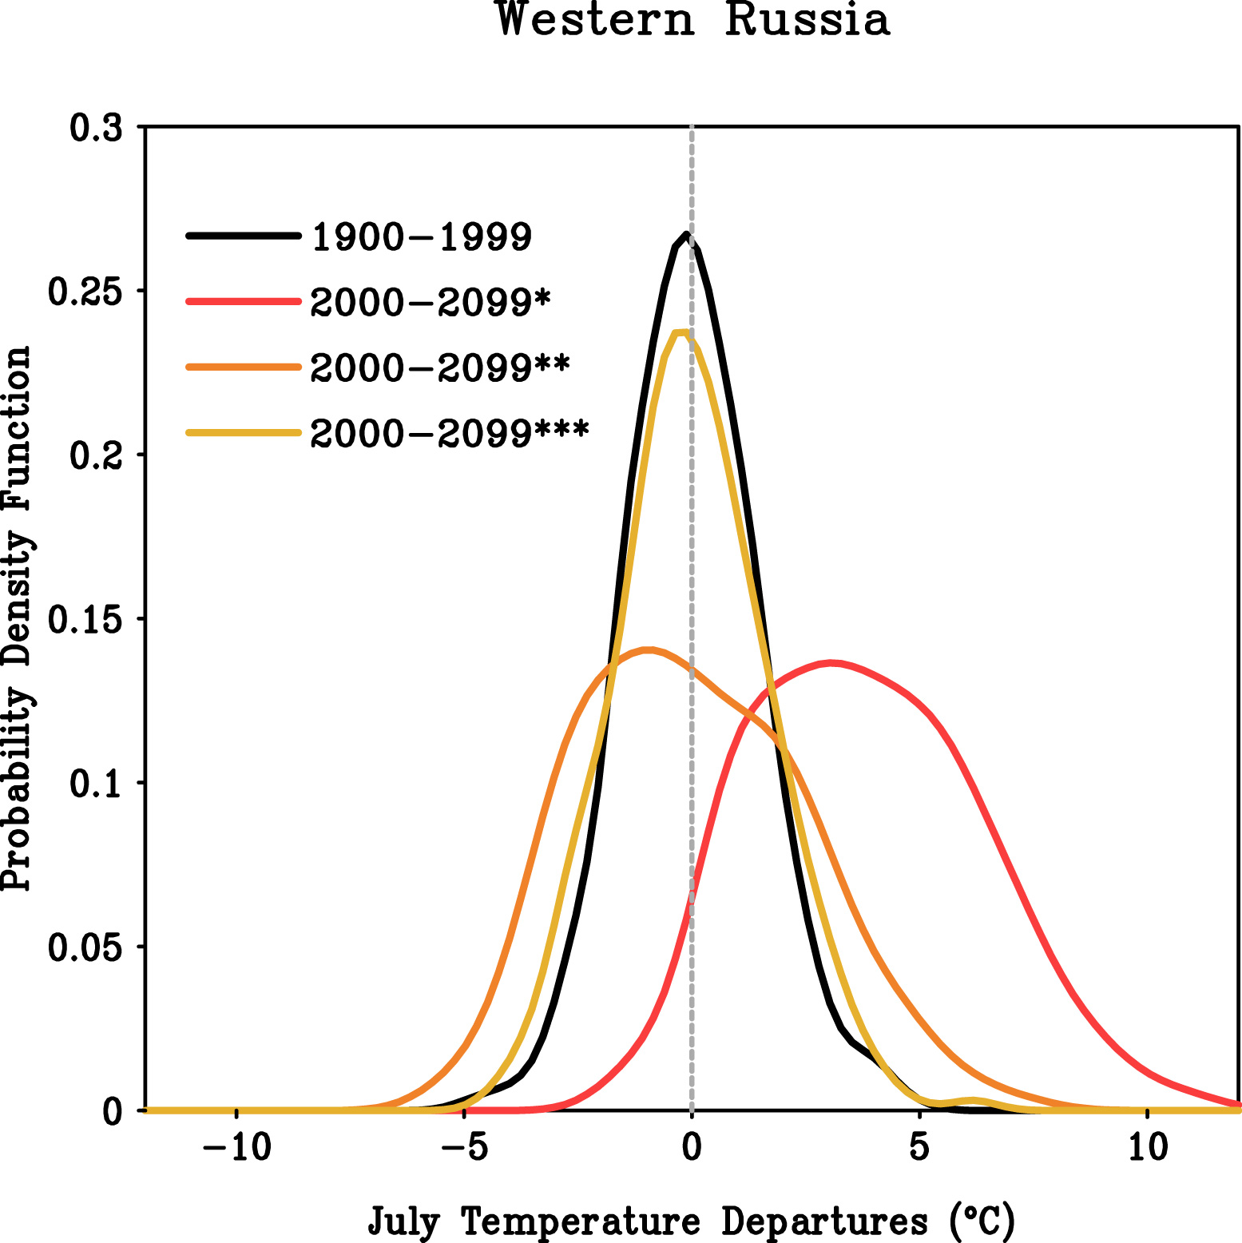
Will There Be Increased Extreme Heat Waves in the 21st Century?
σ² ≈ 2.2°Χ²
σ² ≈ 2.9°Χ²
Σ ≈ 0.3

Slide 26
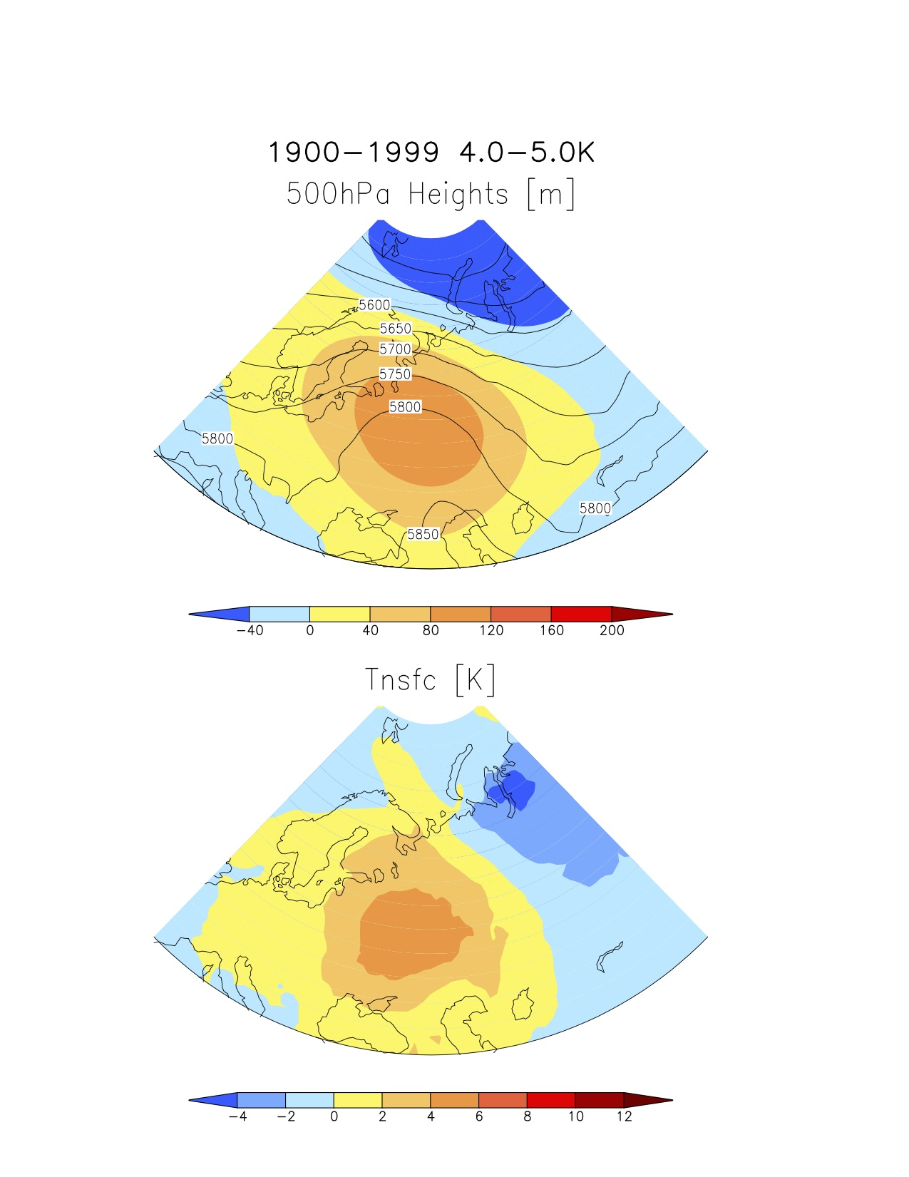
Will Physics of Extreme Heat Waves Change in the 21st Century?
July Heat Waves: 20th Century

Slide 27
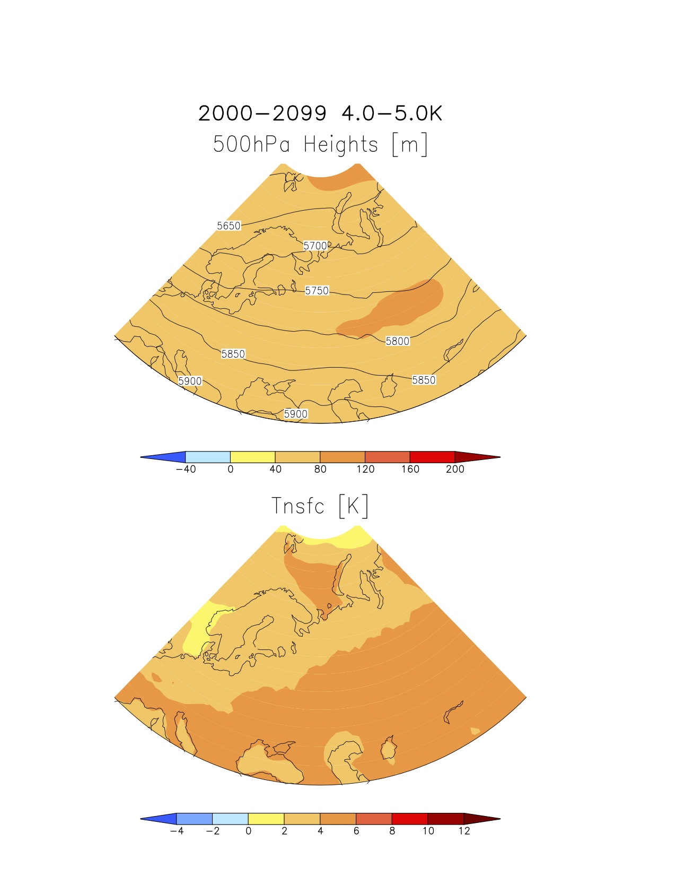
Will Physics of Extreme Heat Waves Change in the 21st Century?
July Heat Waves: 20th Century
July Heat Waves: 21st Century*
CCSM4: Emissions Scenario “Message 8.5”

Slide 28
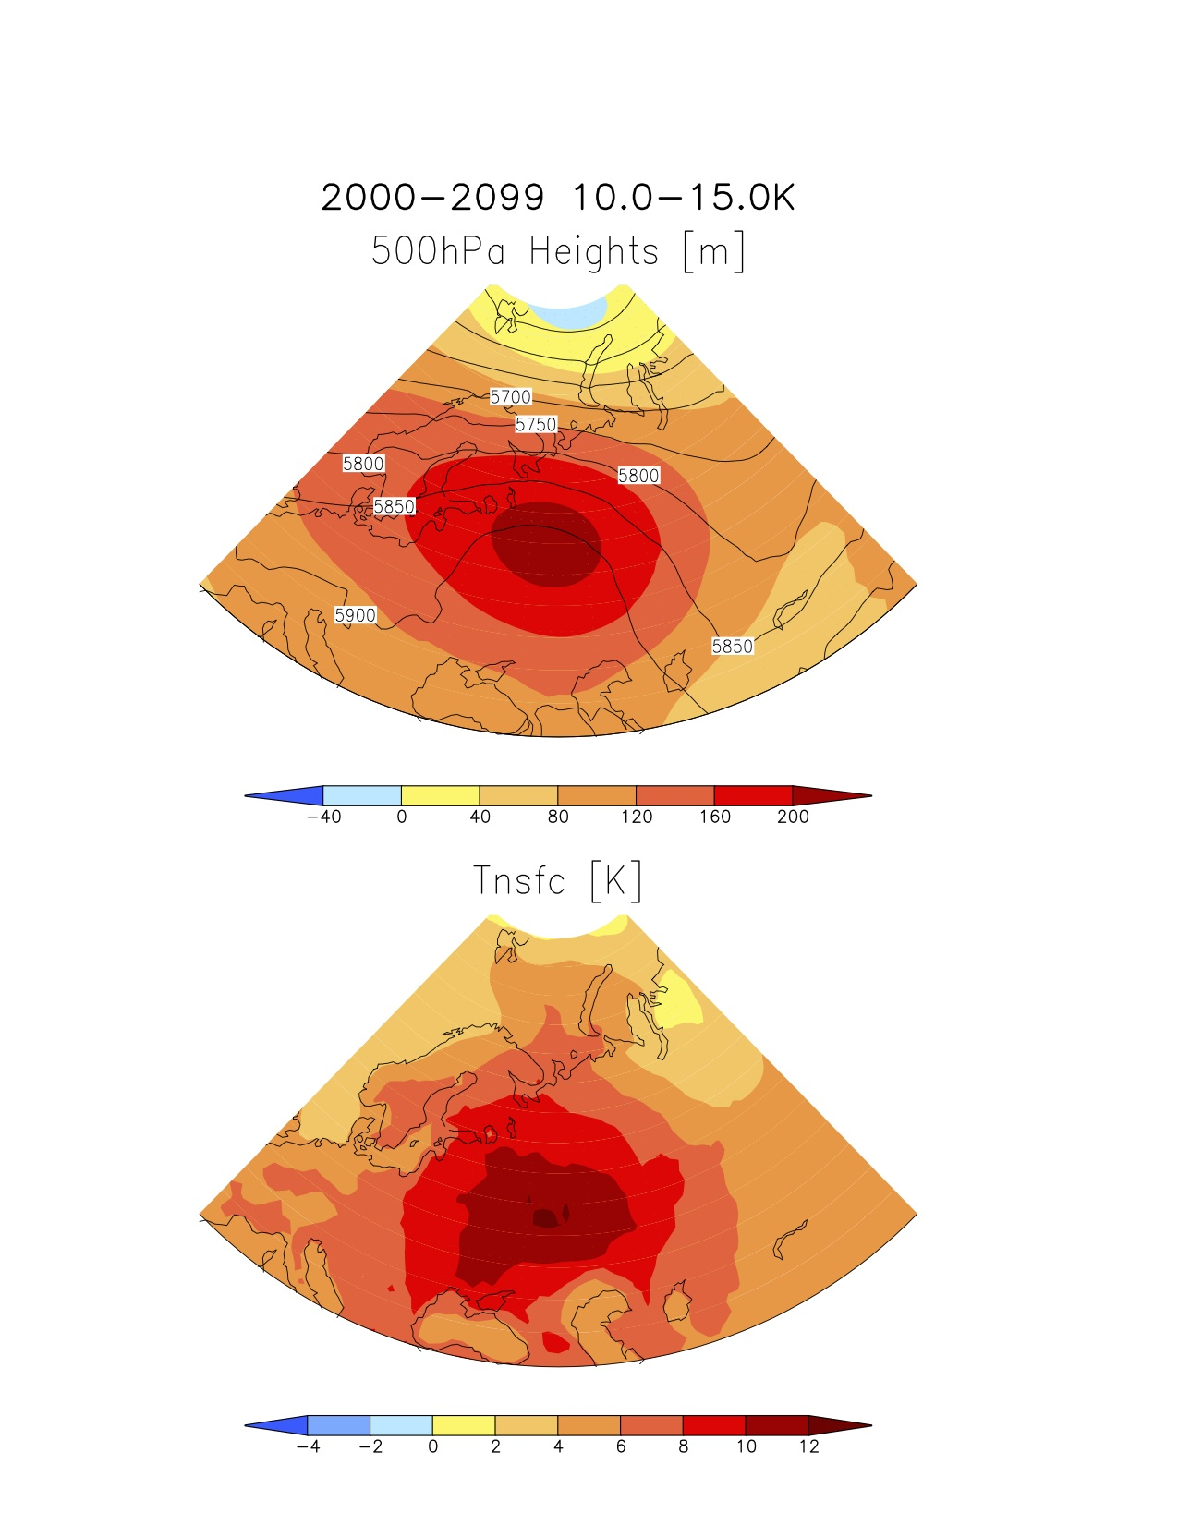
Will Physics of Extreme Heat Waves Change in the 21st Century?
July Heat Waves: 20th Century
July Heat Waves: 21st Century**
CCSM4: Emissions Scenario “Message 8.5”

Slide 29
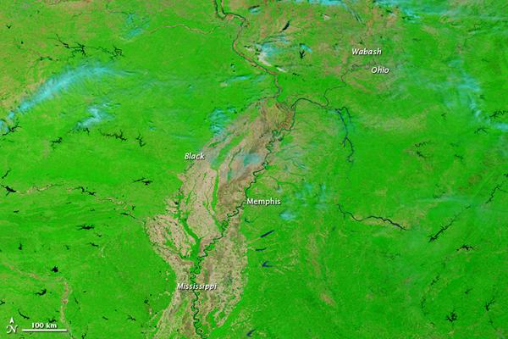
April 29 2010
MODIS

Slide 30
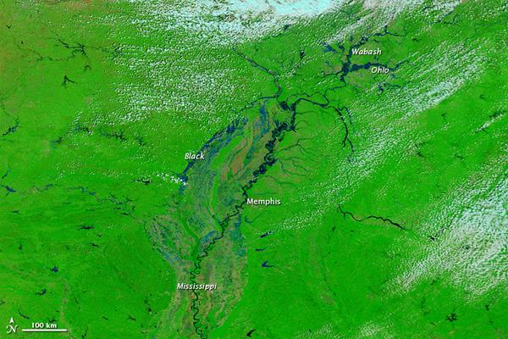
April 28 2011
MODIS

Slide 31
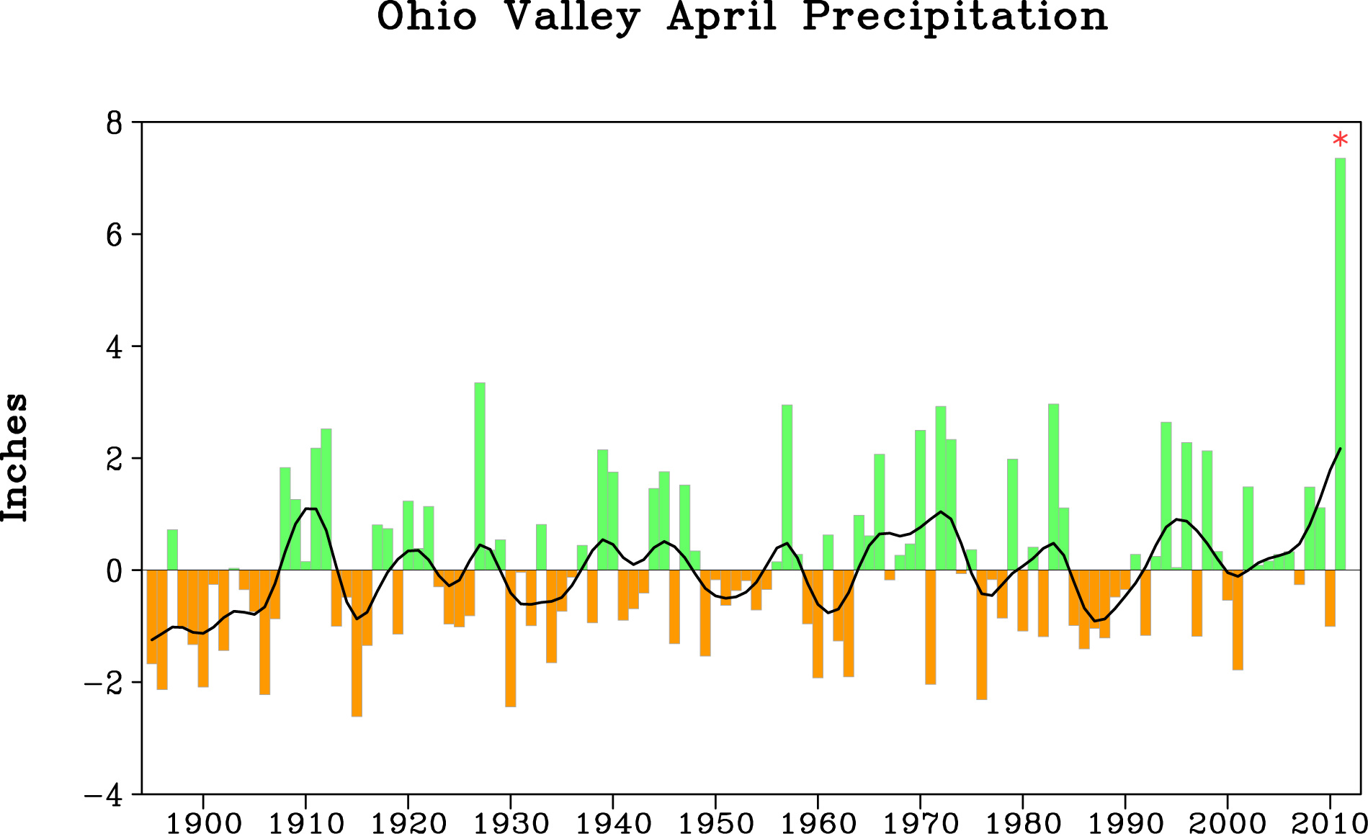

Slide 32
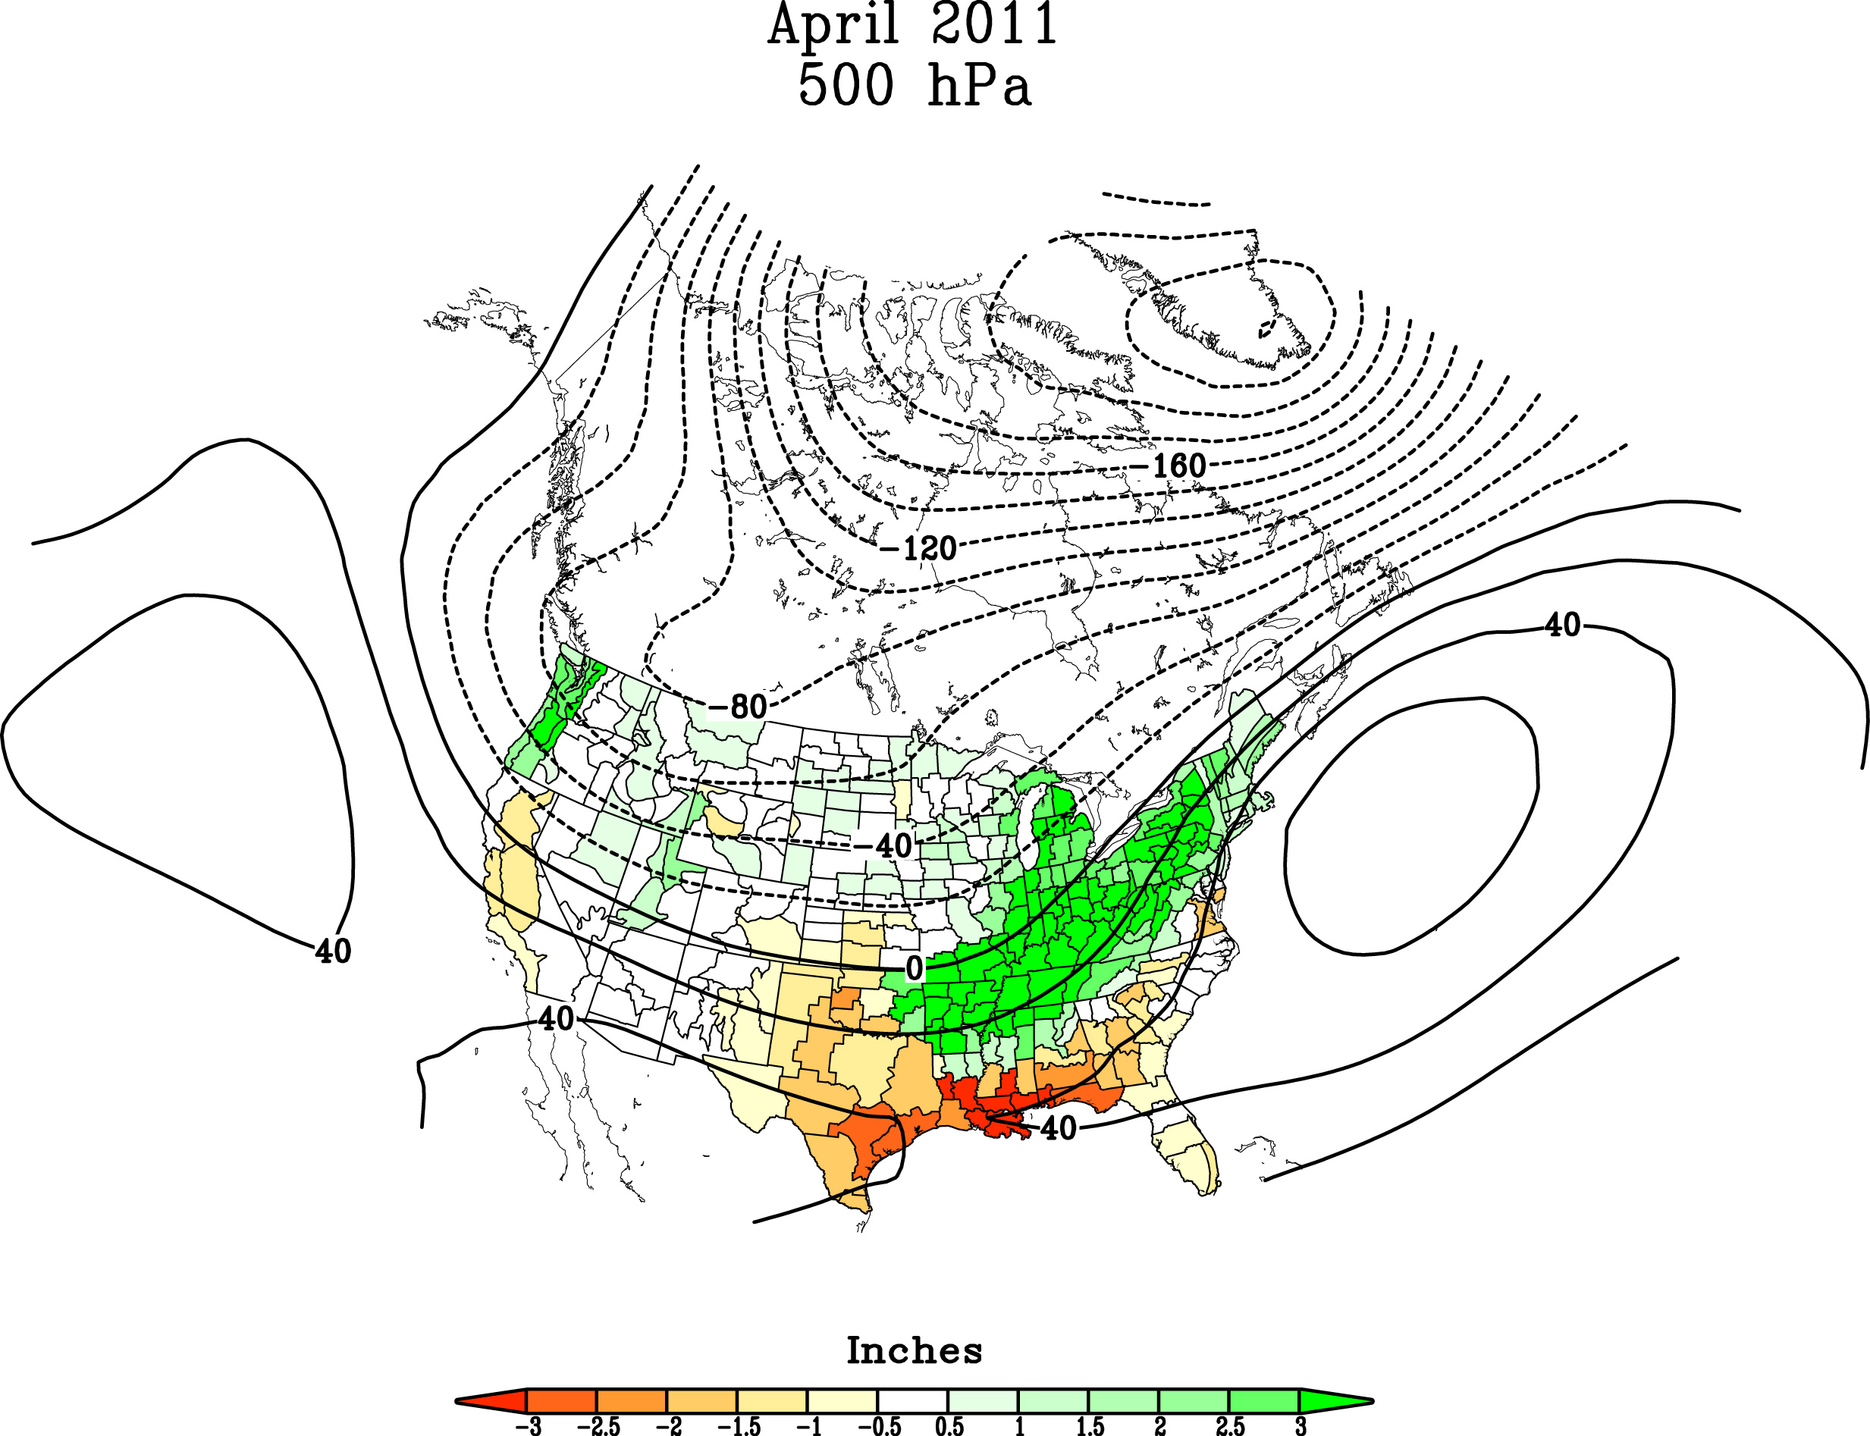
Persistent Synoptic Forcing of the Heavy Rains in 2011
L
H
H

Slide 33
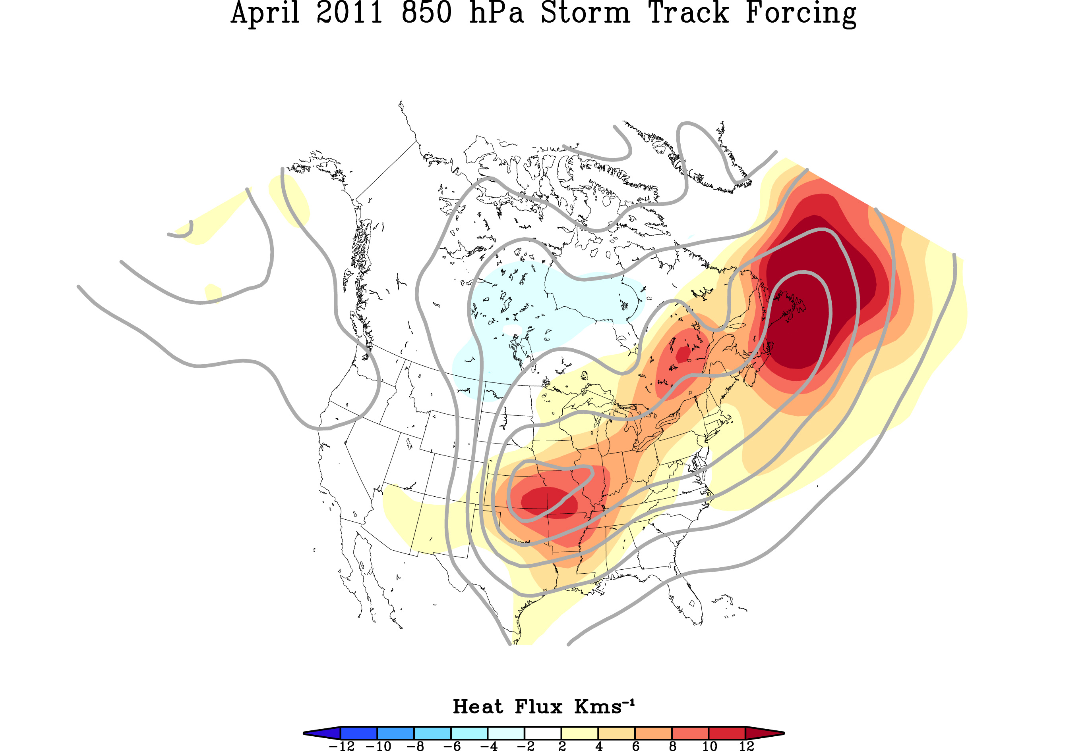
Persistent Synoptic Forcing of the Heavy Rains in 2011

Slide 34
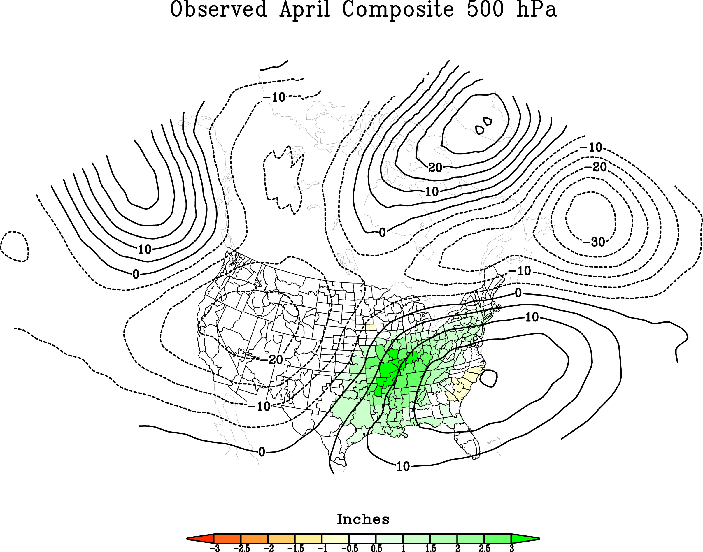
Monthly Averaged 500 hPa Heights Not Strong Determinant of Heavy April Rains
H
H
L
L
H

Slide 35
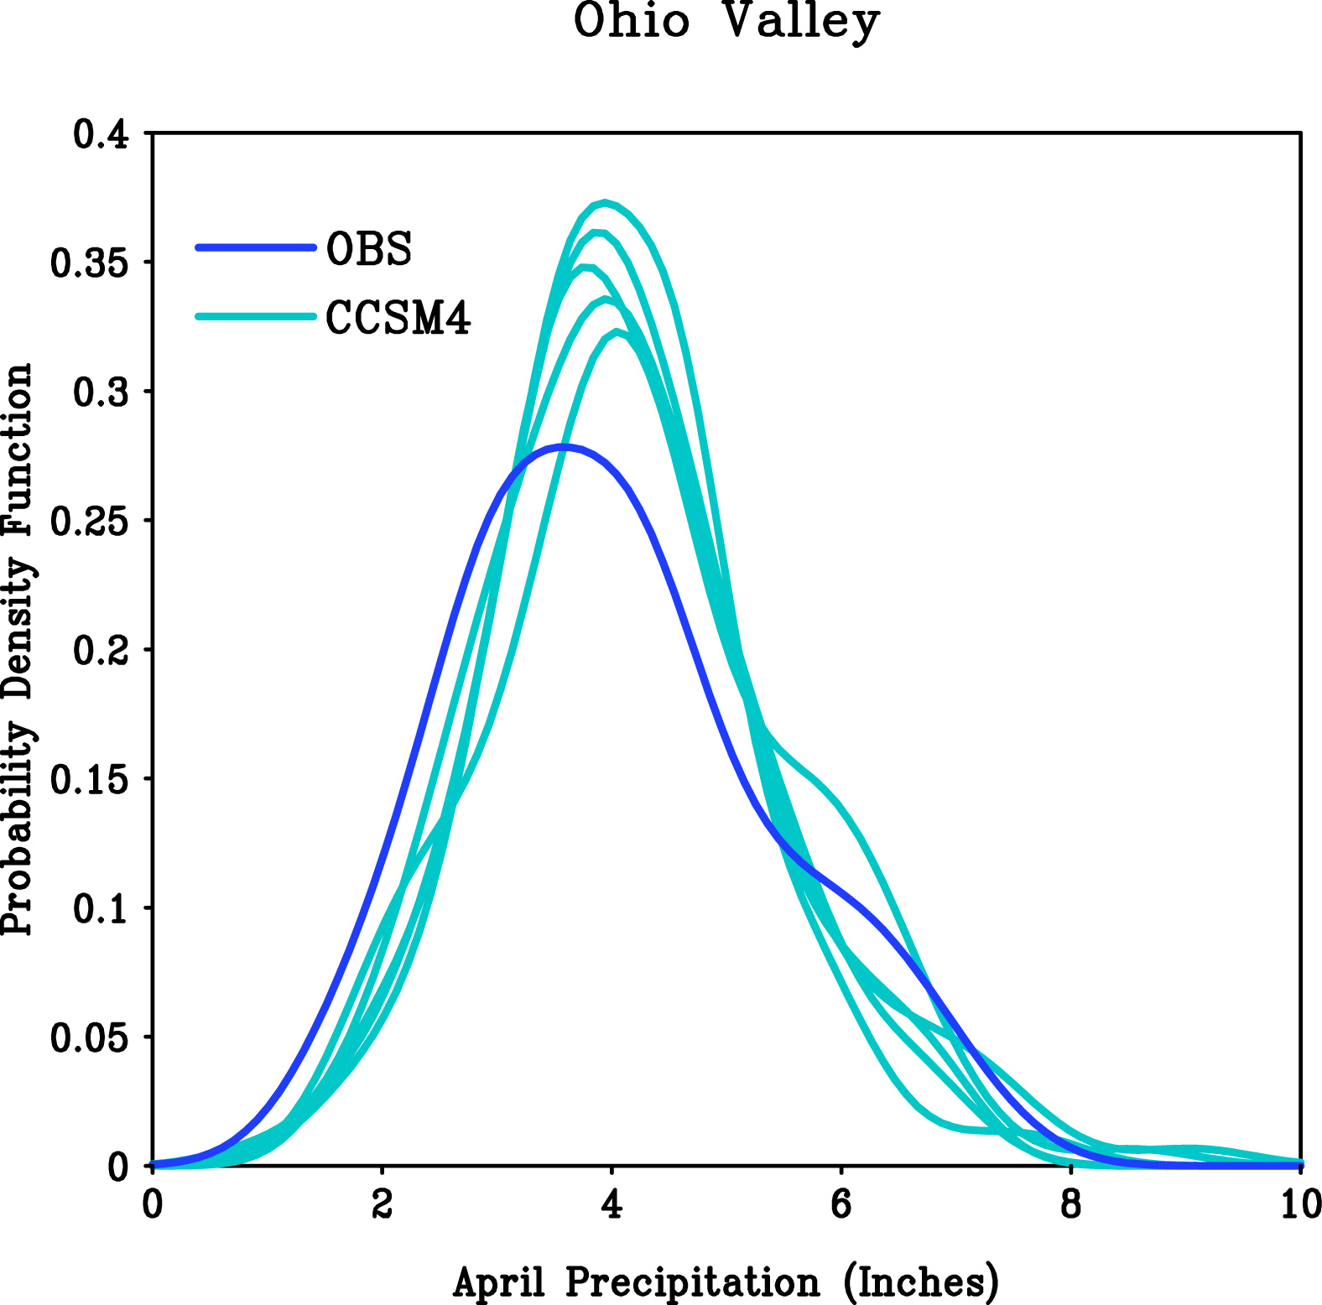
Statistics of April Monthly PCPN: Observed vs Simulations
little mean bias

Slide 36
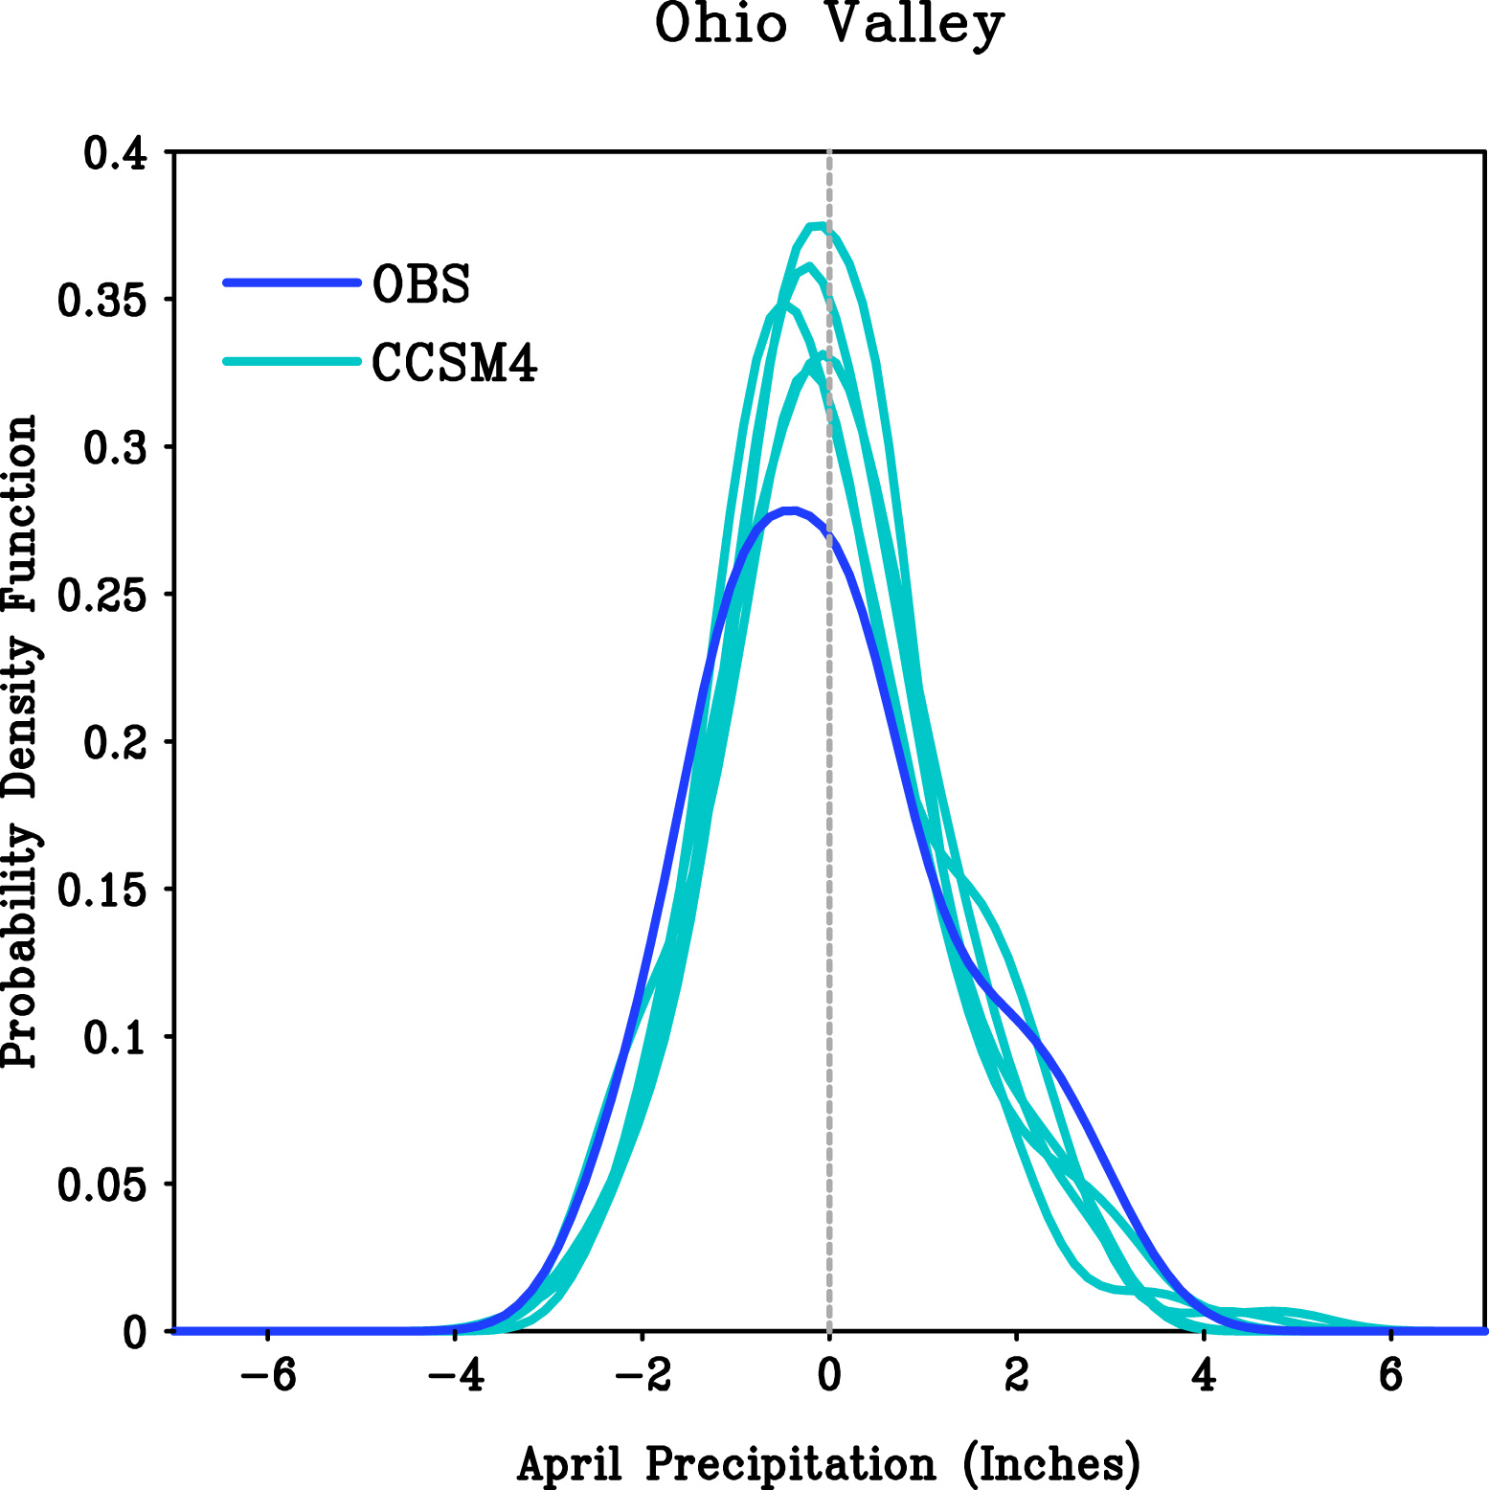
Statistics of April Monthly PCPN Anomalies : Observed vs Simulations
σ_{οβσ}² ≈ 1.8 ιν²
σ_{χσμ}² ≈ 1.3 ιν²
Σ ≈ 0.4
2011

Slide 37
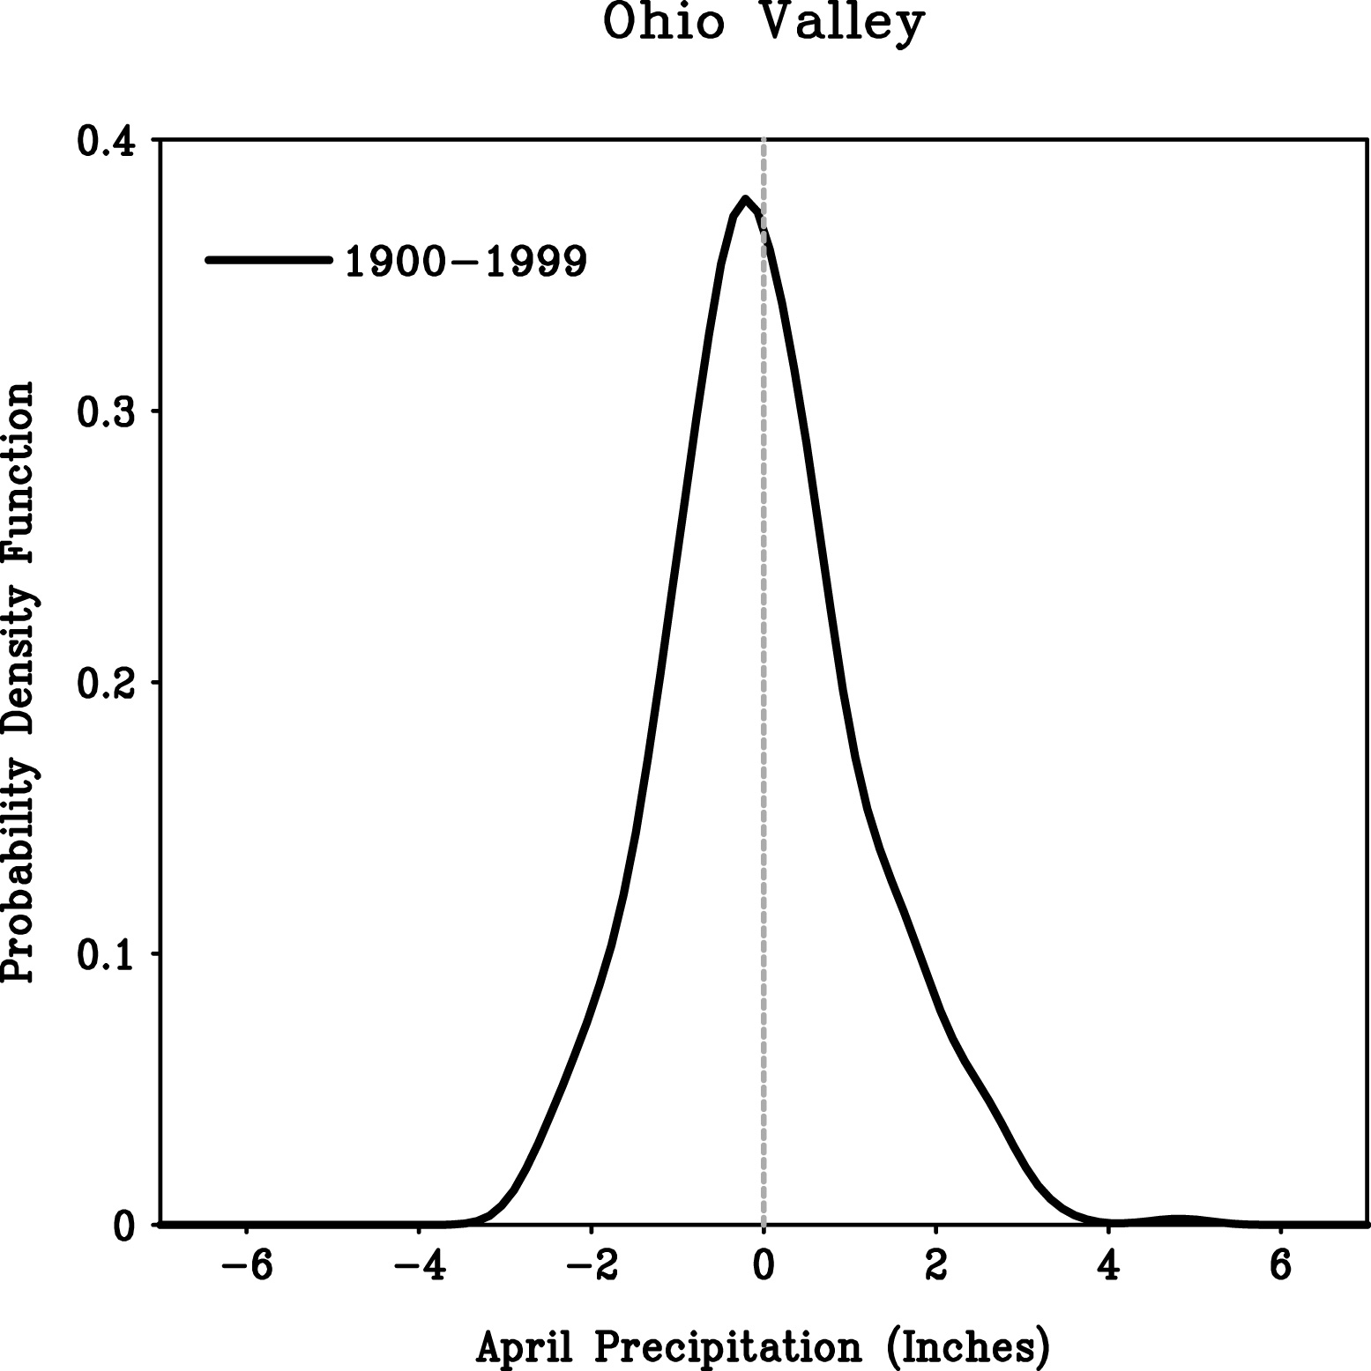
The 2011 Extreme Rains: Climate Change or Climate Variability?
σ² ≈ 1.3 ιν²
Σ ≈ 0.40

Slide 38
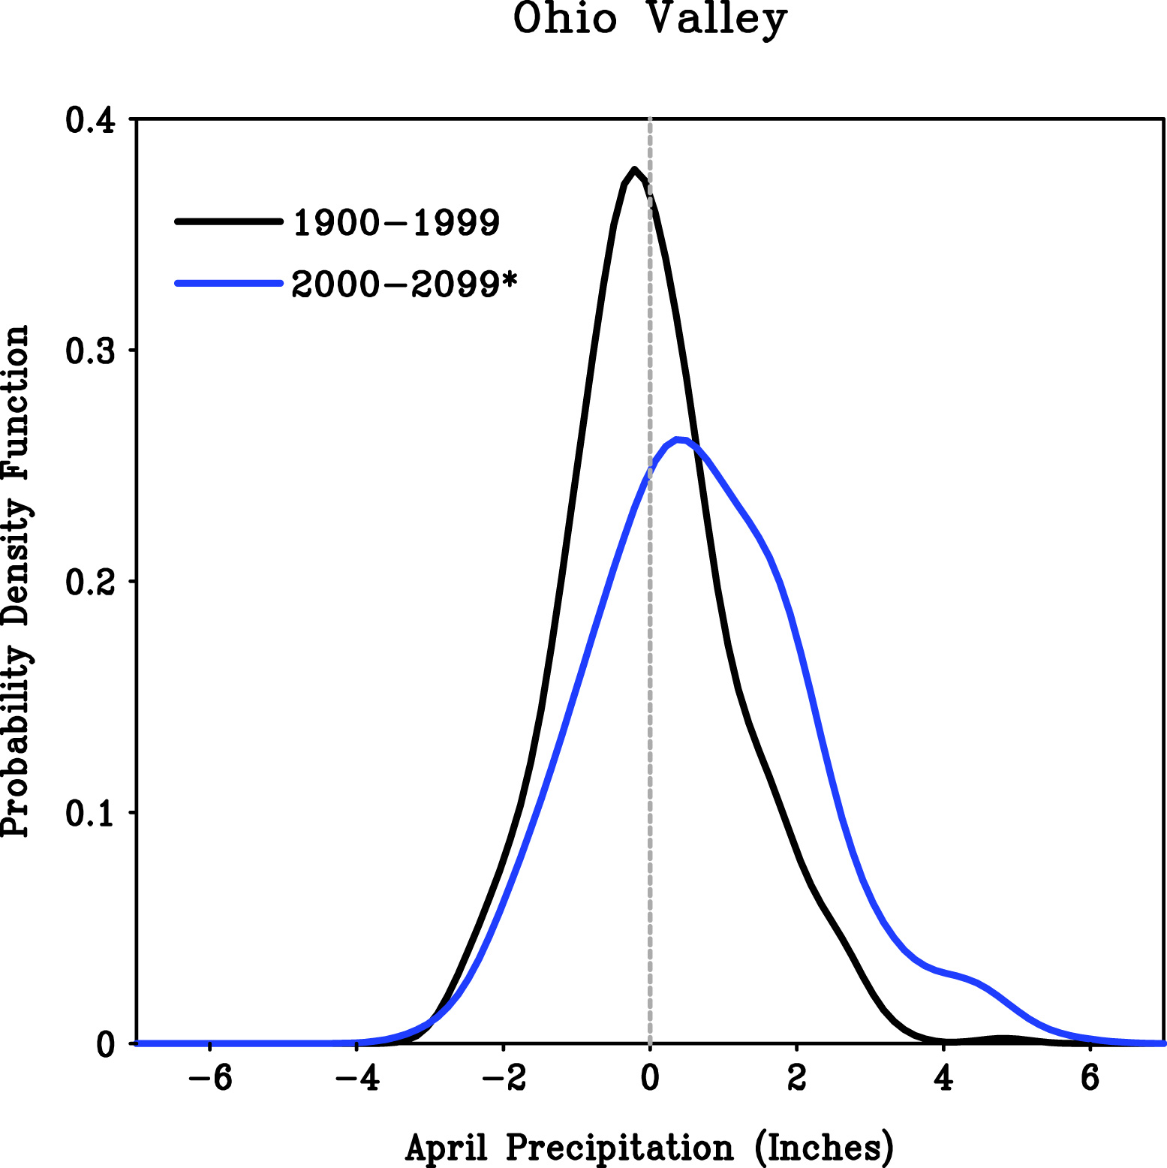
The 2011 Extreme Rains: Climate Change or Climate Variability?
σ² ≈ 2.3 ιν²
Σ ≈ 0.38
2011
CCSM4 Emissions Scenario “Message 8.5”

Slide 39
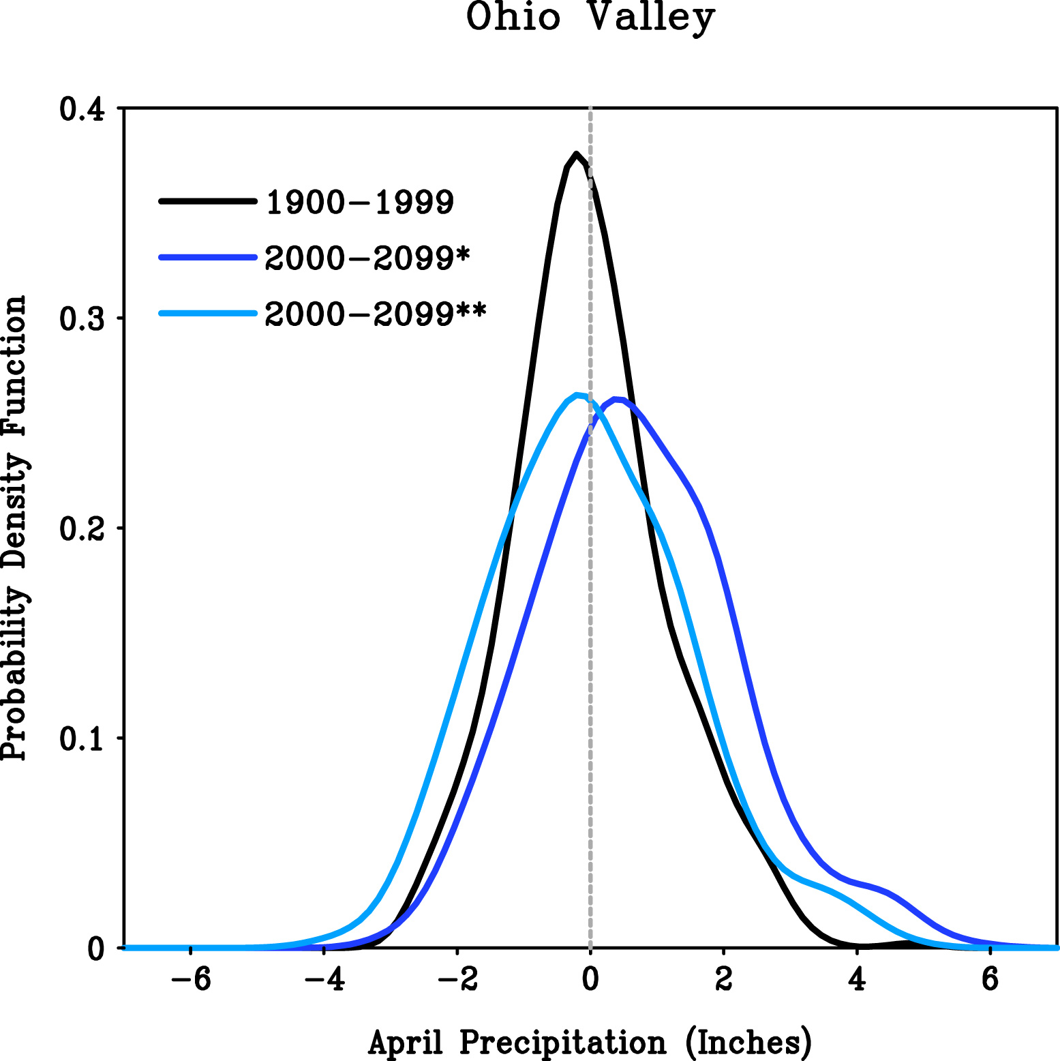
The 2011 Extreme Rains: Climate Change or Climate Variability?
σ² ≈ 2.2 ιν²
Σ ≈ 0.35
CCSM4 Emissions Scenario “Message 8.5”

Slide 40
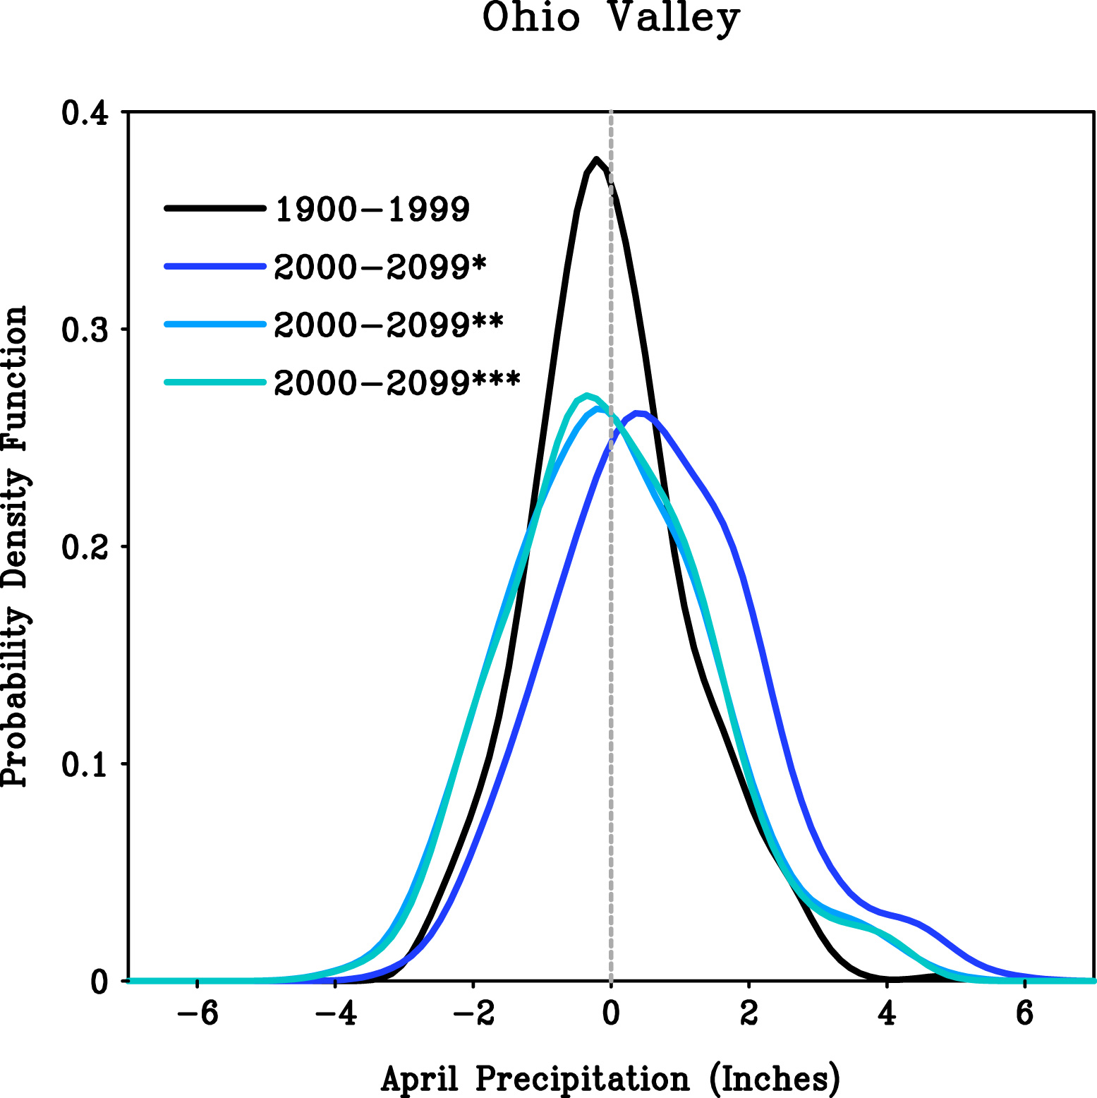
The 2011 Extreme Rains: Climate Change or Climate Variability?
σ² ≈ 2.1 ιν²
Σ ≈ 0.34
CCSM4 Emissions Scenario “Message 8.5”

Slide 41
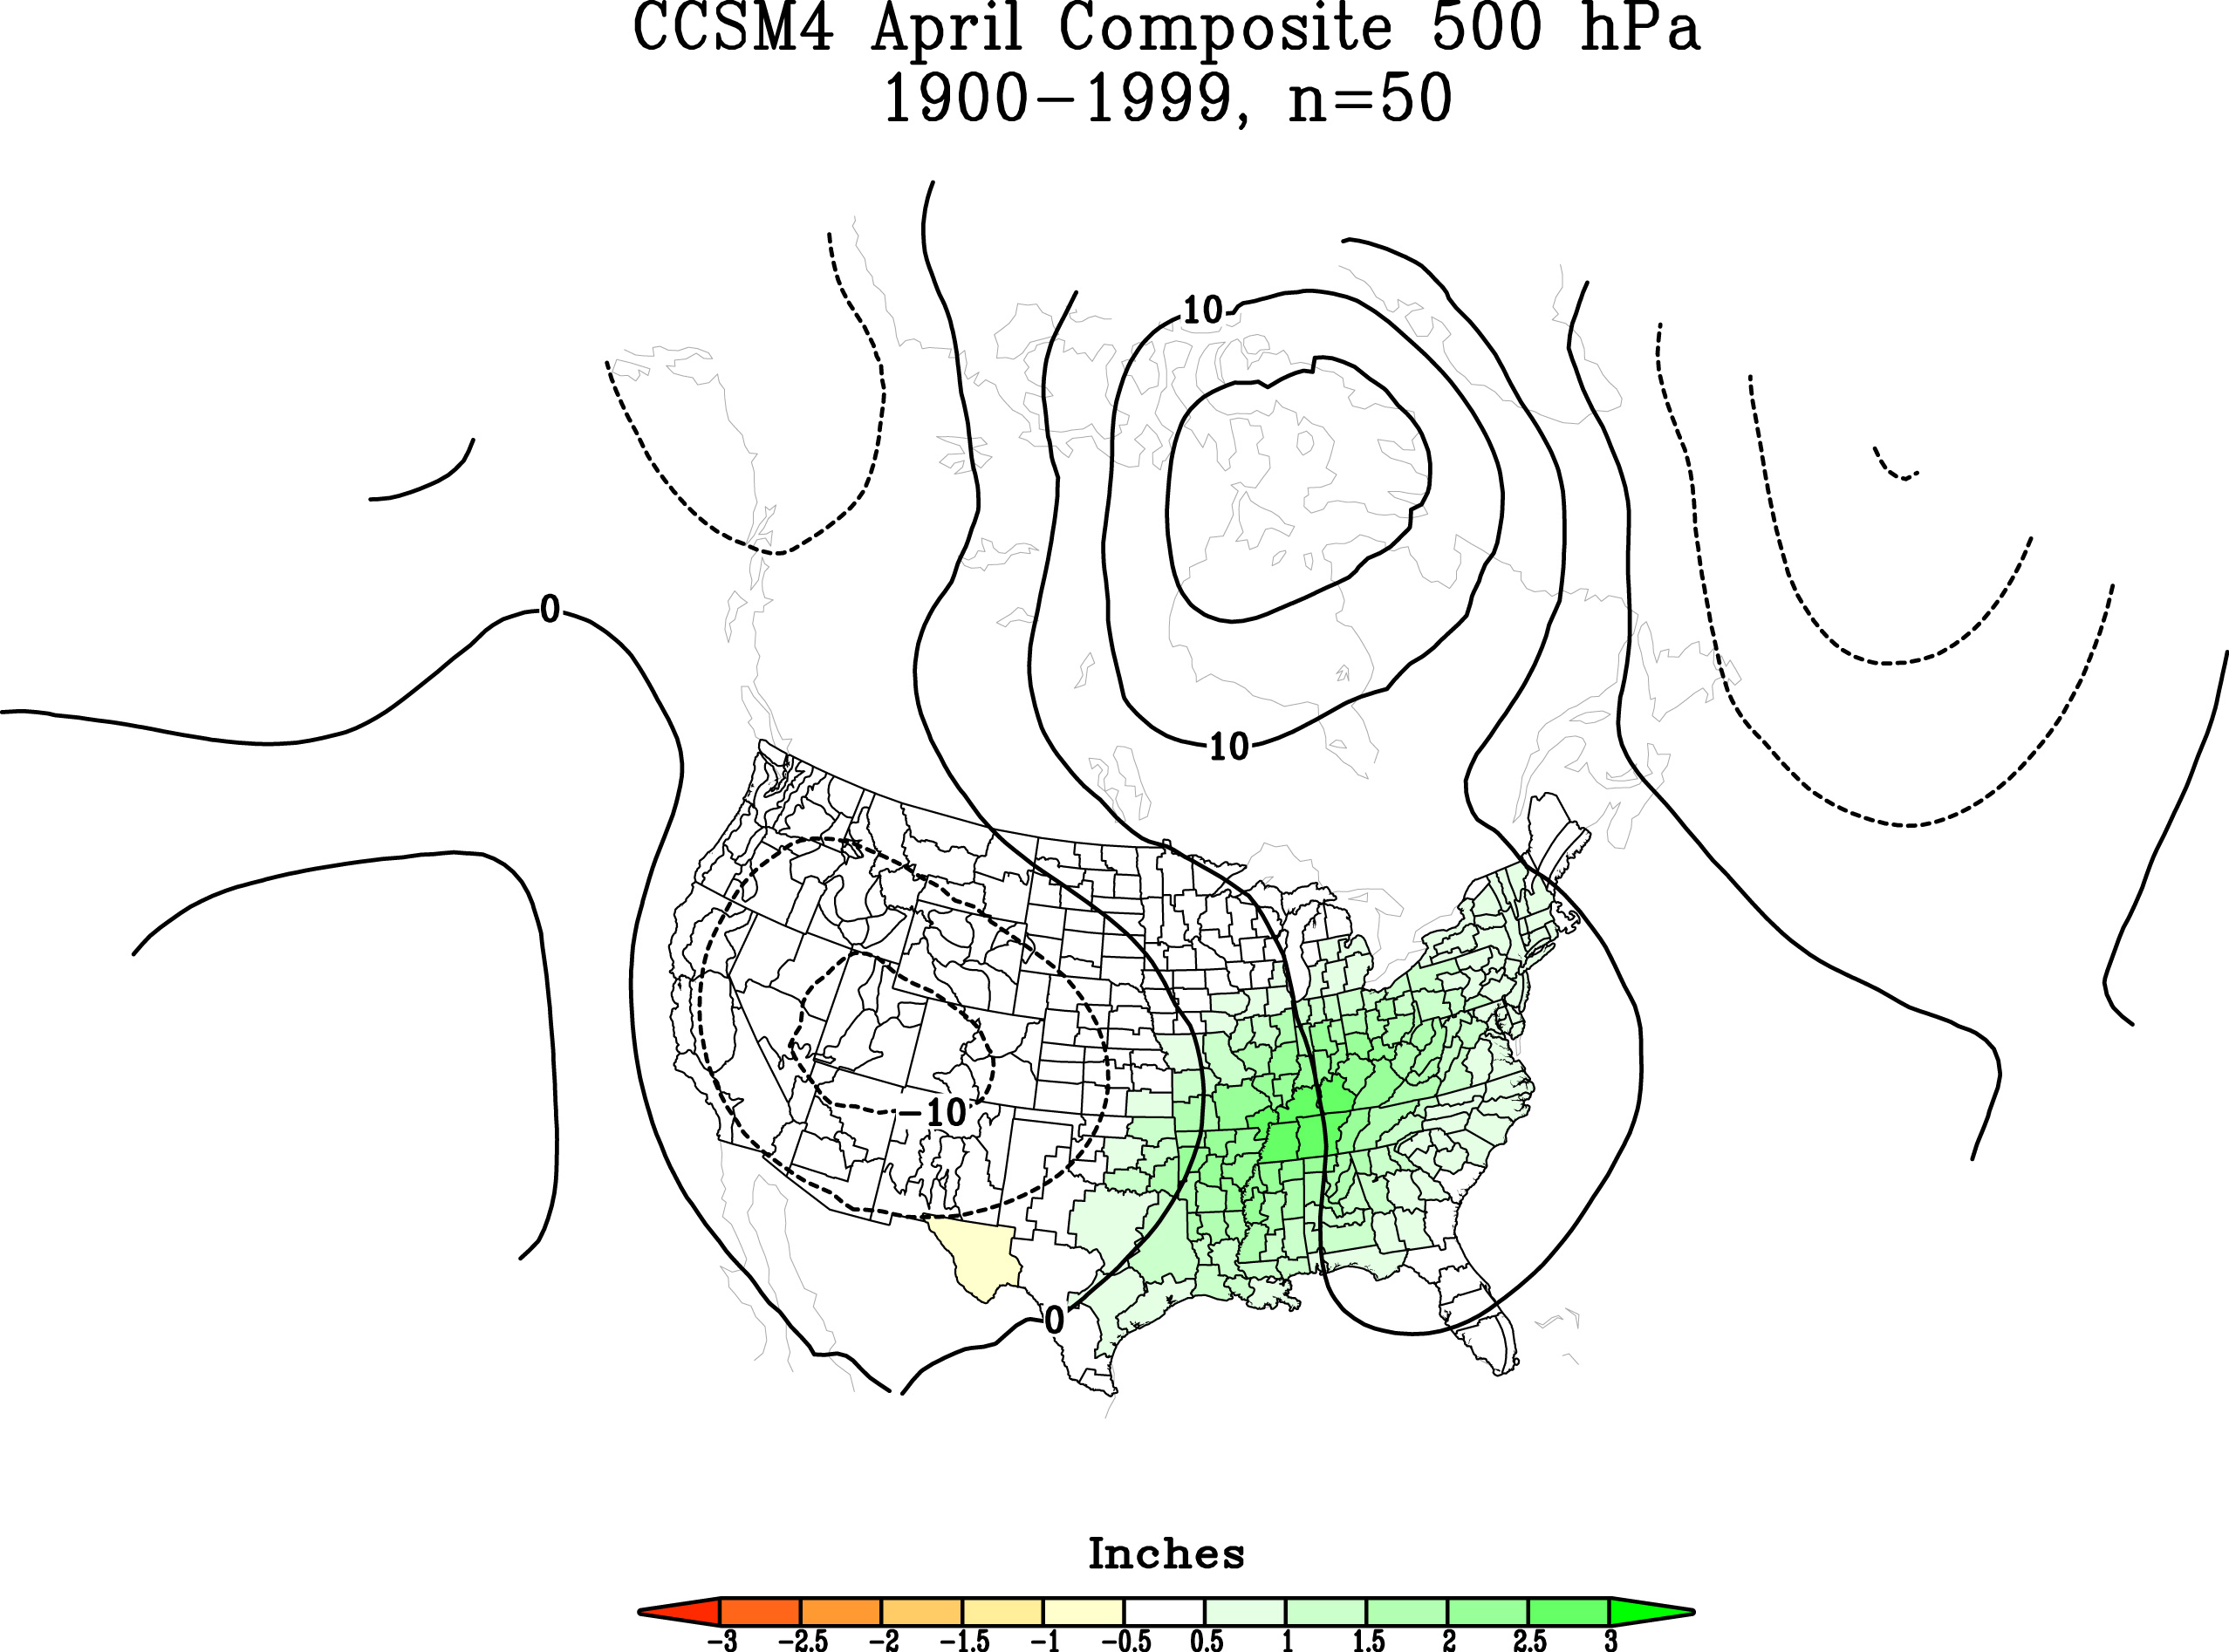
Circulation and Ohio Valley Extreme Wet Aprils During the 20th Century in CCSM4

Slide 42
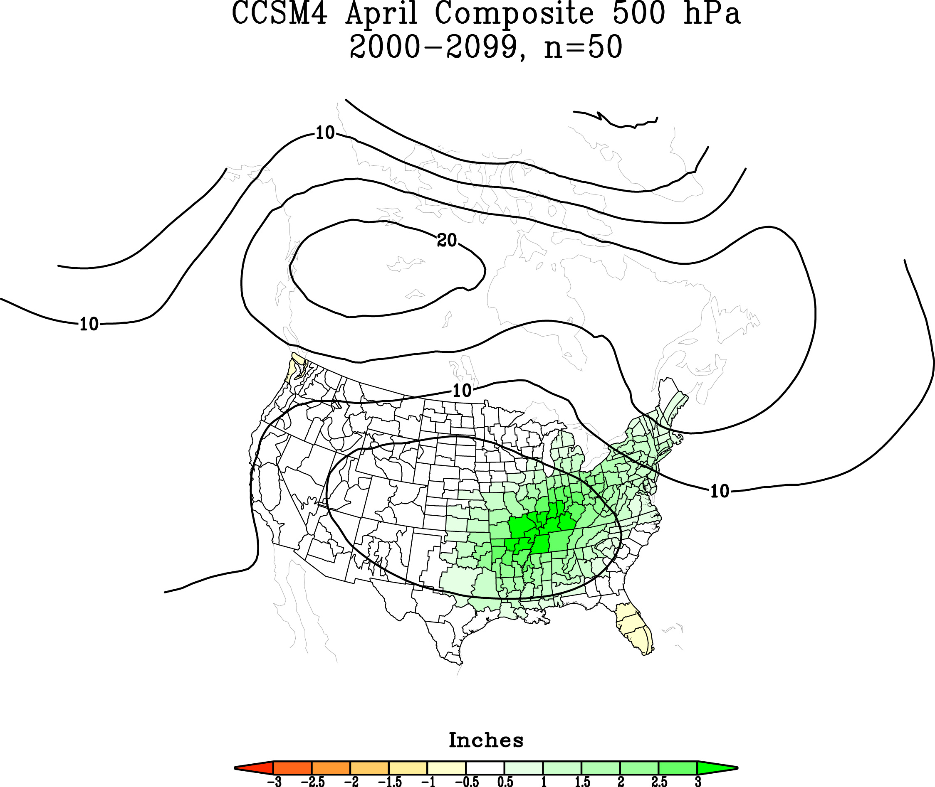
Circulation and Ohio Valley Extreme Wet Aprils During the 21st Century in CCSM4

Slide 43
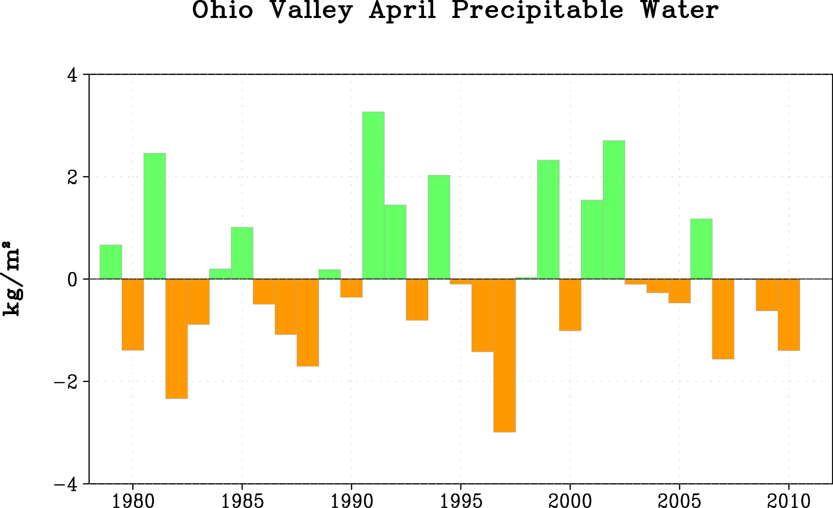
Atmospheric Water Vapor: Has It Increased Over the Ohio Valley?

Slide 44
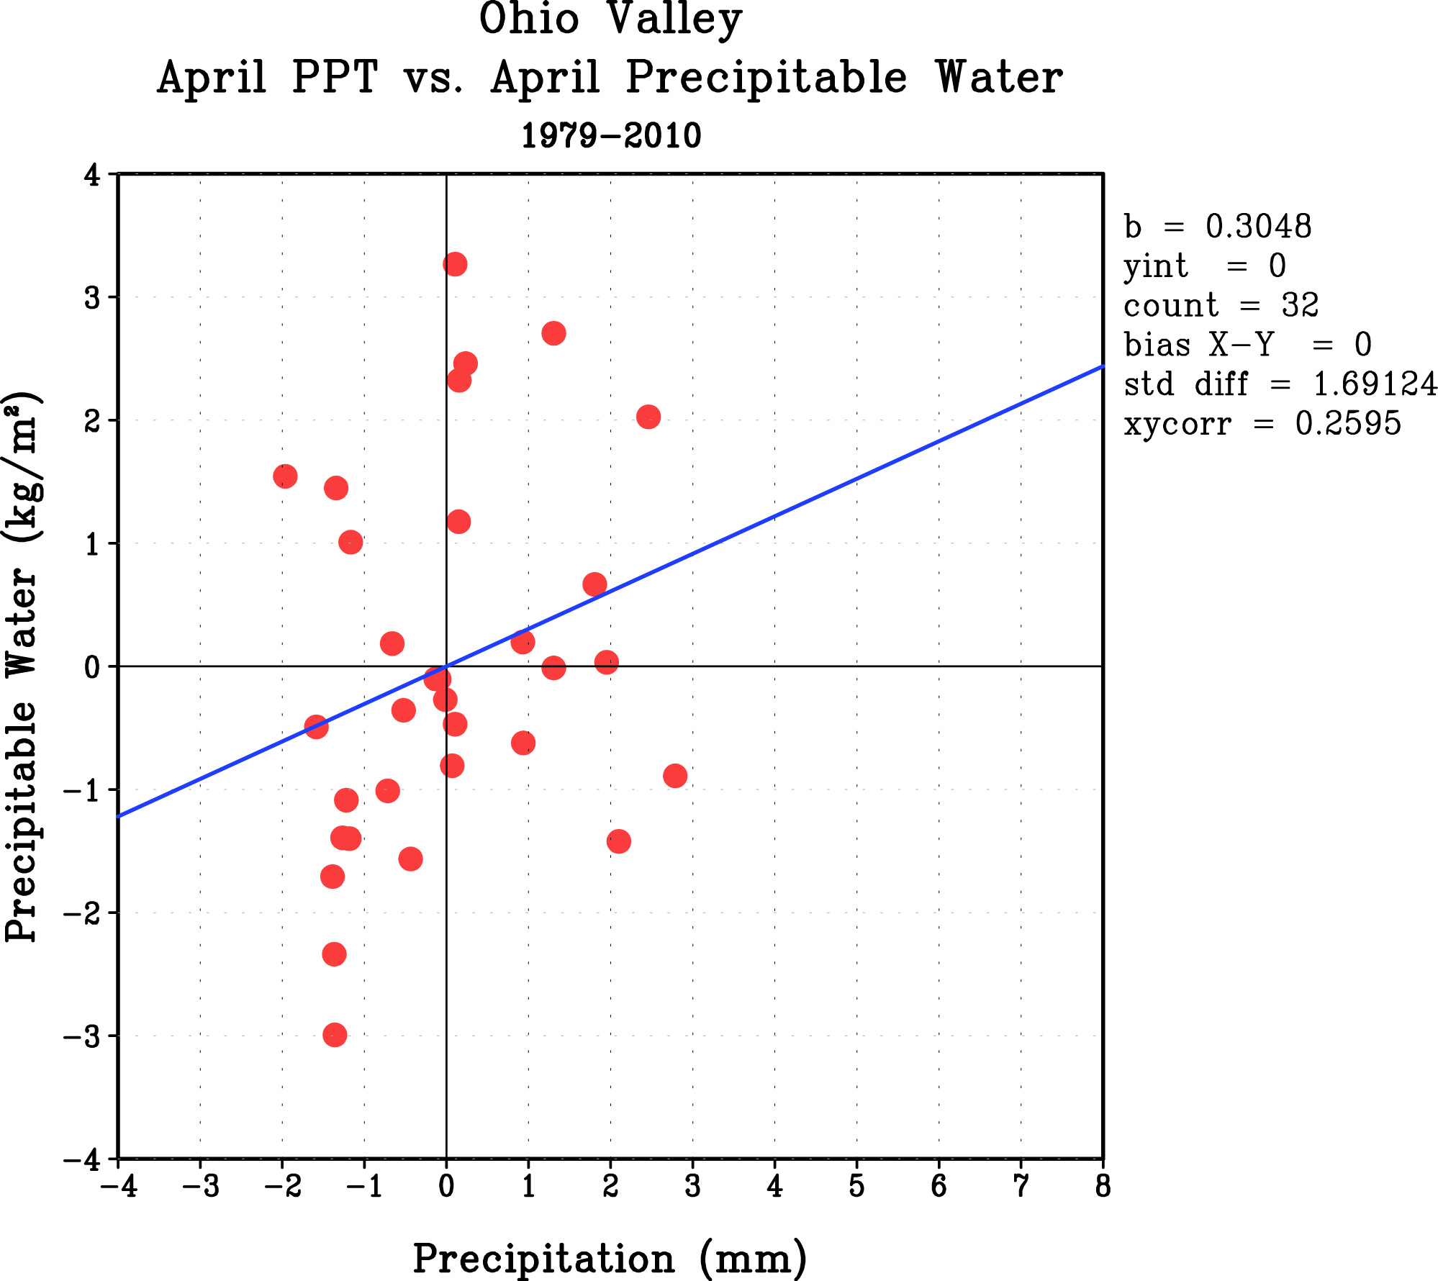
Does Monthly Atmospheric Water Vapor Determine Monthly Rainfall?
R = 0.26

